Slide 1
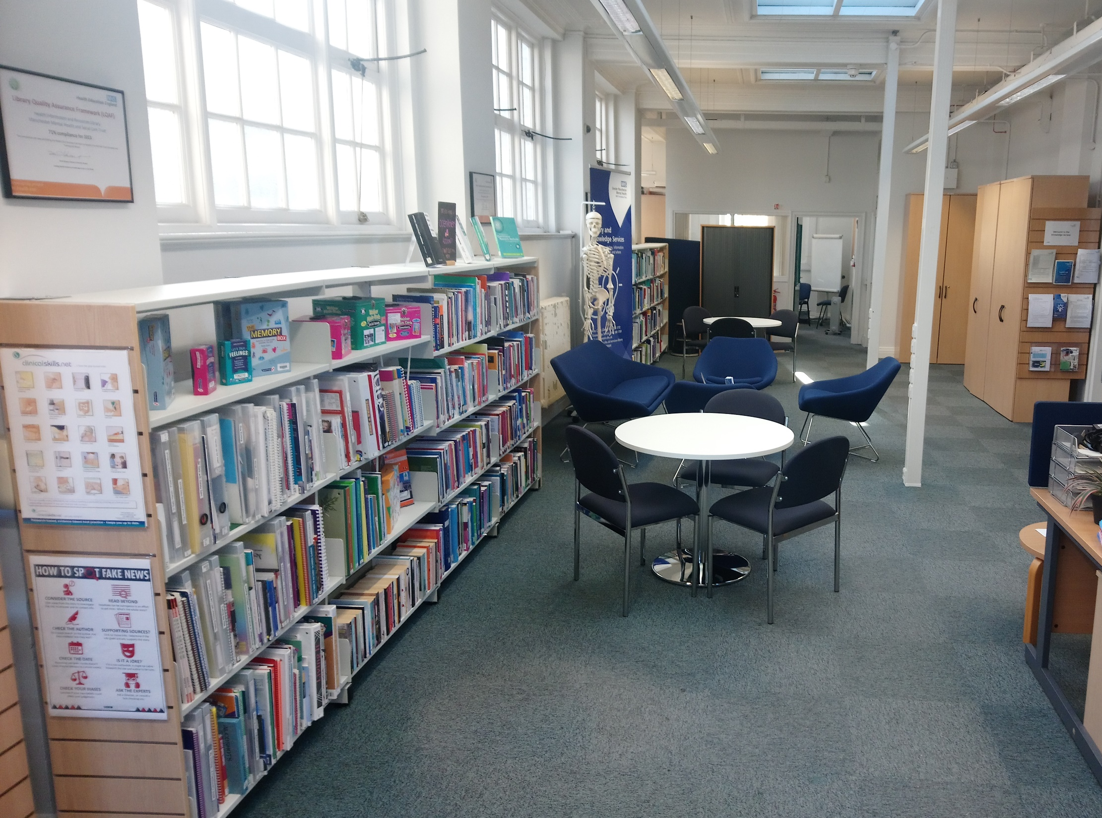


Tailored search and synthesis service
Lorna Dawson
Public Health & Engagement Librarian
lorna.dawson@gmmh.nhs.uk
Library and Knowledge Services
buzz Health and Wellbeing Service
Greater Manchester Mental Health NHS Foundation Trust
Notes:
Lorna Dawson
Public Health & Engagement Librarian GMMH
Tailored Search and Synthesis Service

Slide 2


Community development team
Notes:
The Community Development Team is part of Health and Wellbeing Service.
Neighbourhood Health Workers
Ask community what projects they’d like and help make them happen – community grocers, cookery courses, exercise classes, men’s sheds.

Slide 3
Evidence base?
Notes:
Service spec says - evidence-based
June, submitting yearly reporting, evidence was pretty sparse
Some NHWs were good but others rarely or never
There to embed evidence

Slide 4

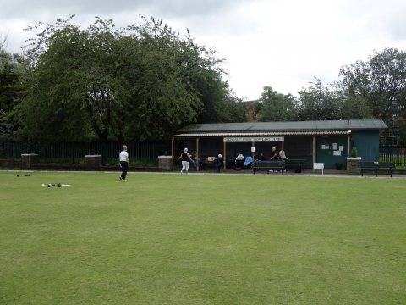

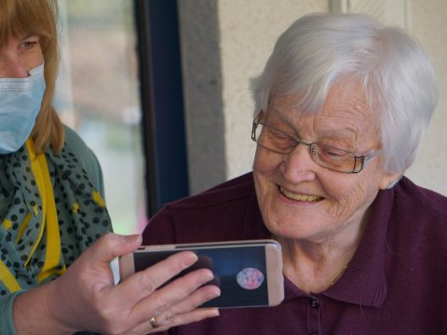
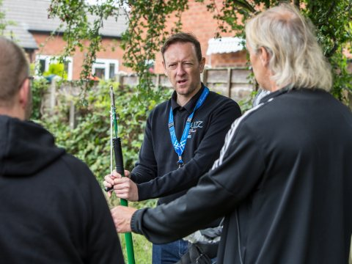
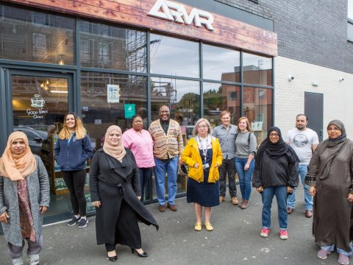
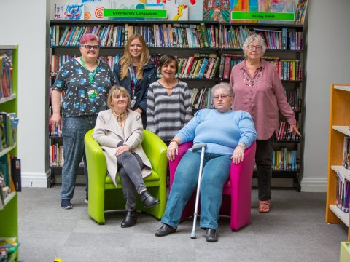
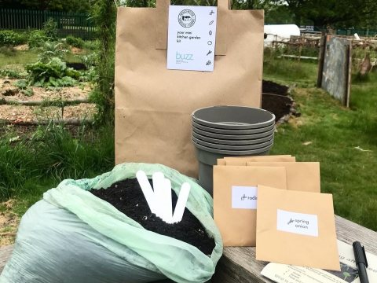
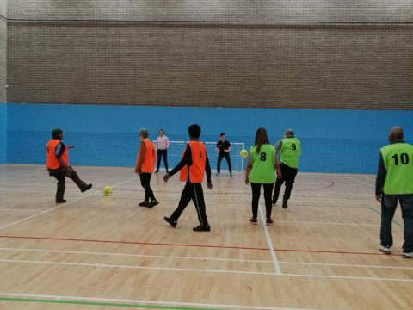
For 23 project themes …
4-5 links to evidence
Summary of benefits
Links
to policies
Notes:
Agreed with the Community Development Manager, we would provide a search and synthesis service
Tailored to the NHW team’s specific needs
23 project themes which required evidence – arts and crafts groups, gardening, peer support groups
Brief summary of the benefits as described in the research
Links to 4-5 key research articles
Links to relevant local and national policies in the buzz specification.
NHWs copy and paste into their reports - saved time.
Completed in a month – July – team effort from LKS staff

Slide 5
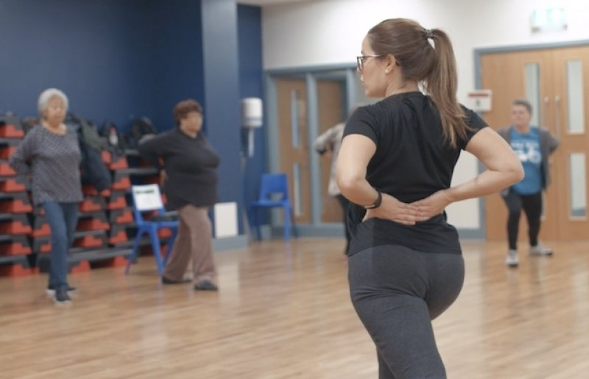
Be flexible
Notes:
So you gave the evidence after – isn’t that the wrong way round?
What did we learn?
We had to be flexible to best suit their needs
Simple as possible
See value
Only having a small number of high quality references – not overwhelming and didn’t put people off using evidence in future
Discussing with Community Development Manager – checking before leaping in
Some ideas were rejected e.g. referencing within the summary of benefits

Slide 6
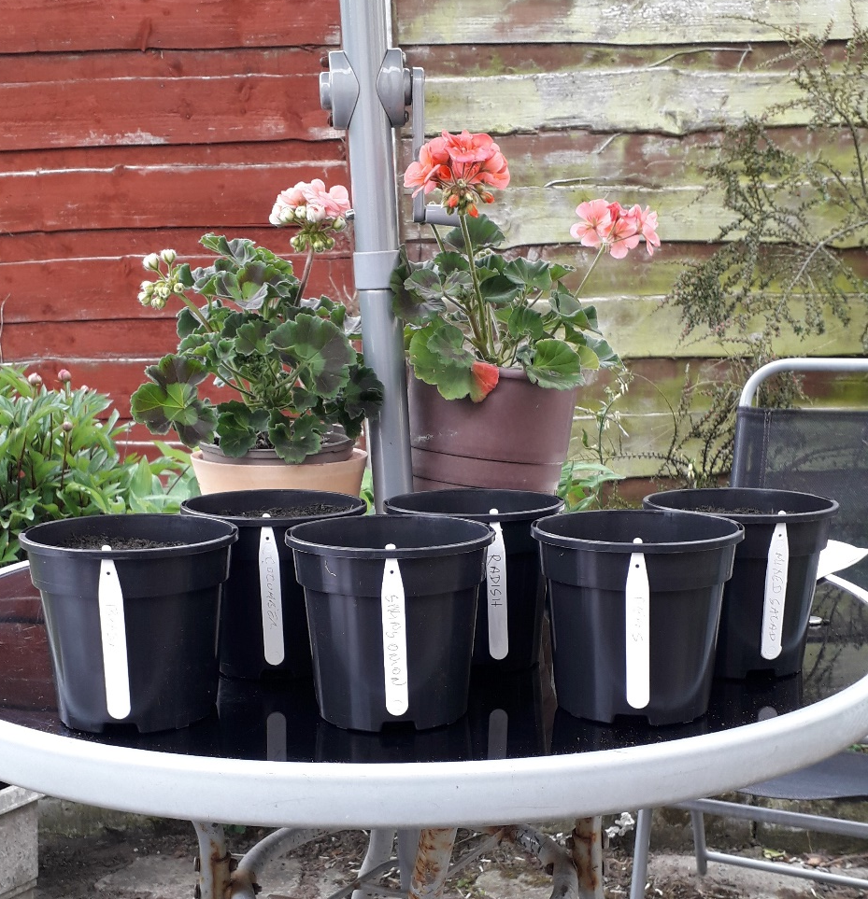
Timing
Notes:
Timing is key – previous efforts to convince hadn’t taken off.
Deadline, needing to fulfil the service spec really helped our case

Slide 7
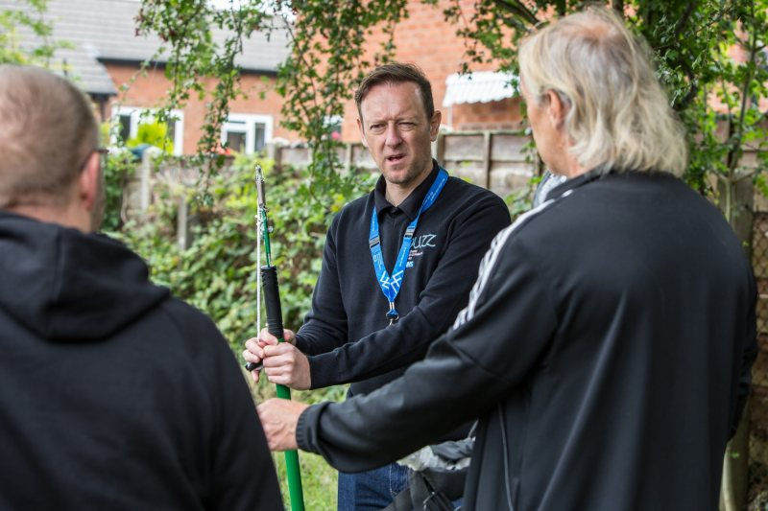
Attitudes to evidence
Notes:
Barriers
Wary of the value of evidence.
Bottom up approach – see evidence as top down
Emphasising that there are different types of evidence which can actually save them time and help make their projects more successful.

Slide 8
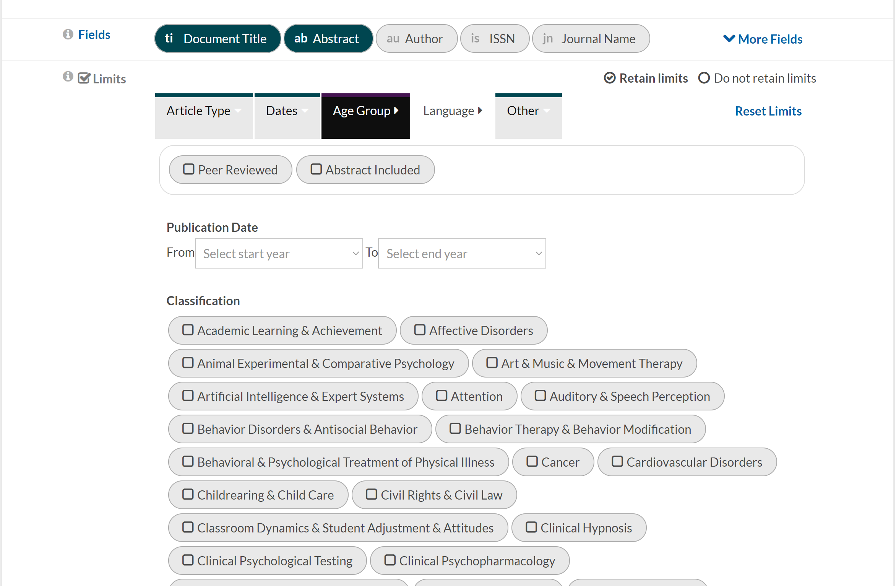
Limits …
Notes:
Article type - open access and freely-available reports
So commissioners could read them
Some key articles could not be included
Dates - Time – short deadline
Themes were broad, sometimes encompassing several sub-themes,
Narrow results to 5 key articles and then summarise them
4 of us doing the searches
Self-assigned to a theme when time available to fit around workload

Slide 9
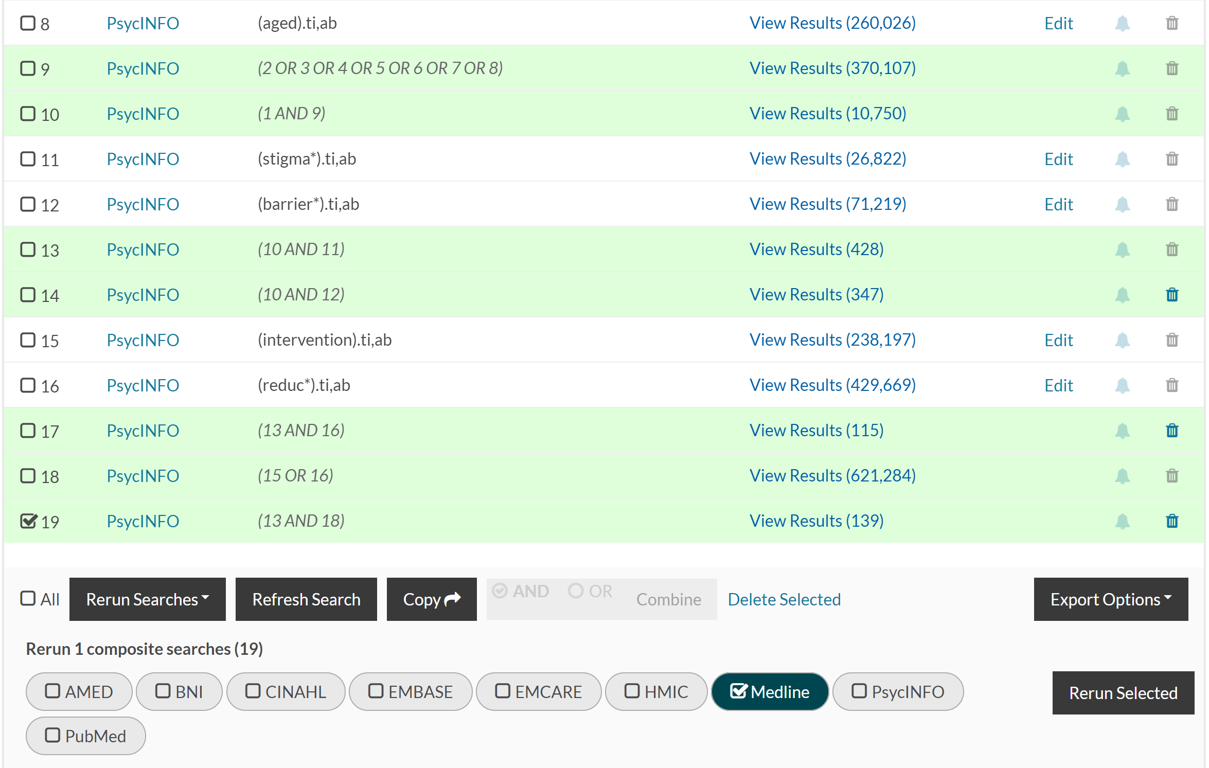
Rerun selected?
Notes:
Risk – same situation next year
Follow up emails – new project, new synthesis
Embedded helps

Slide 10
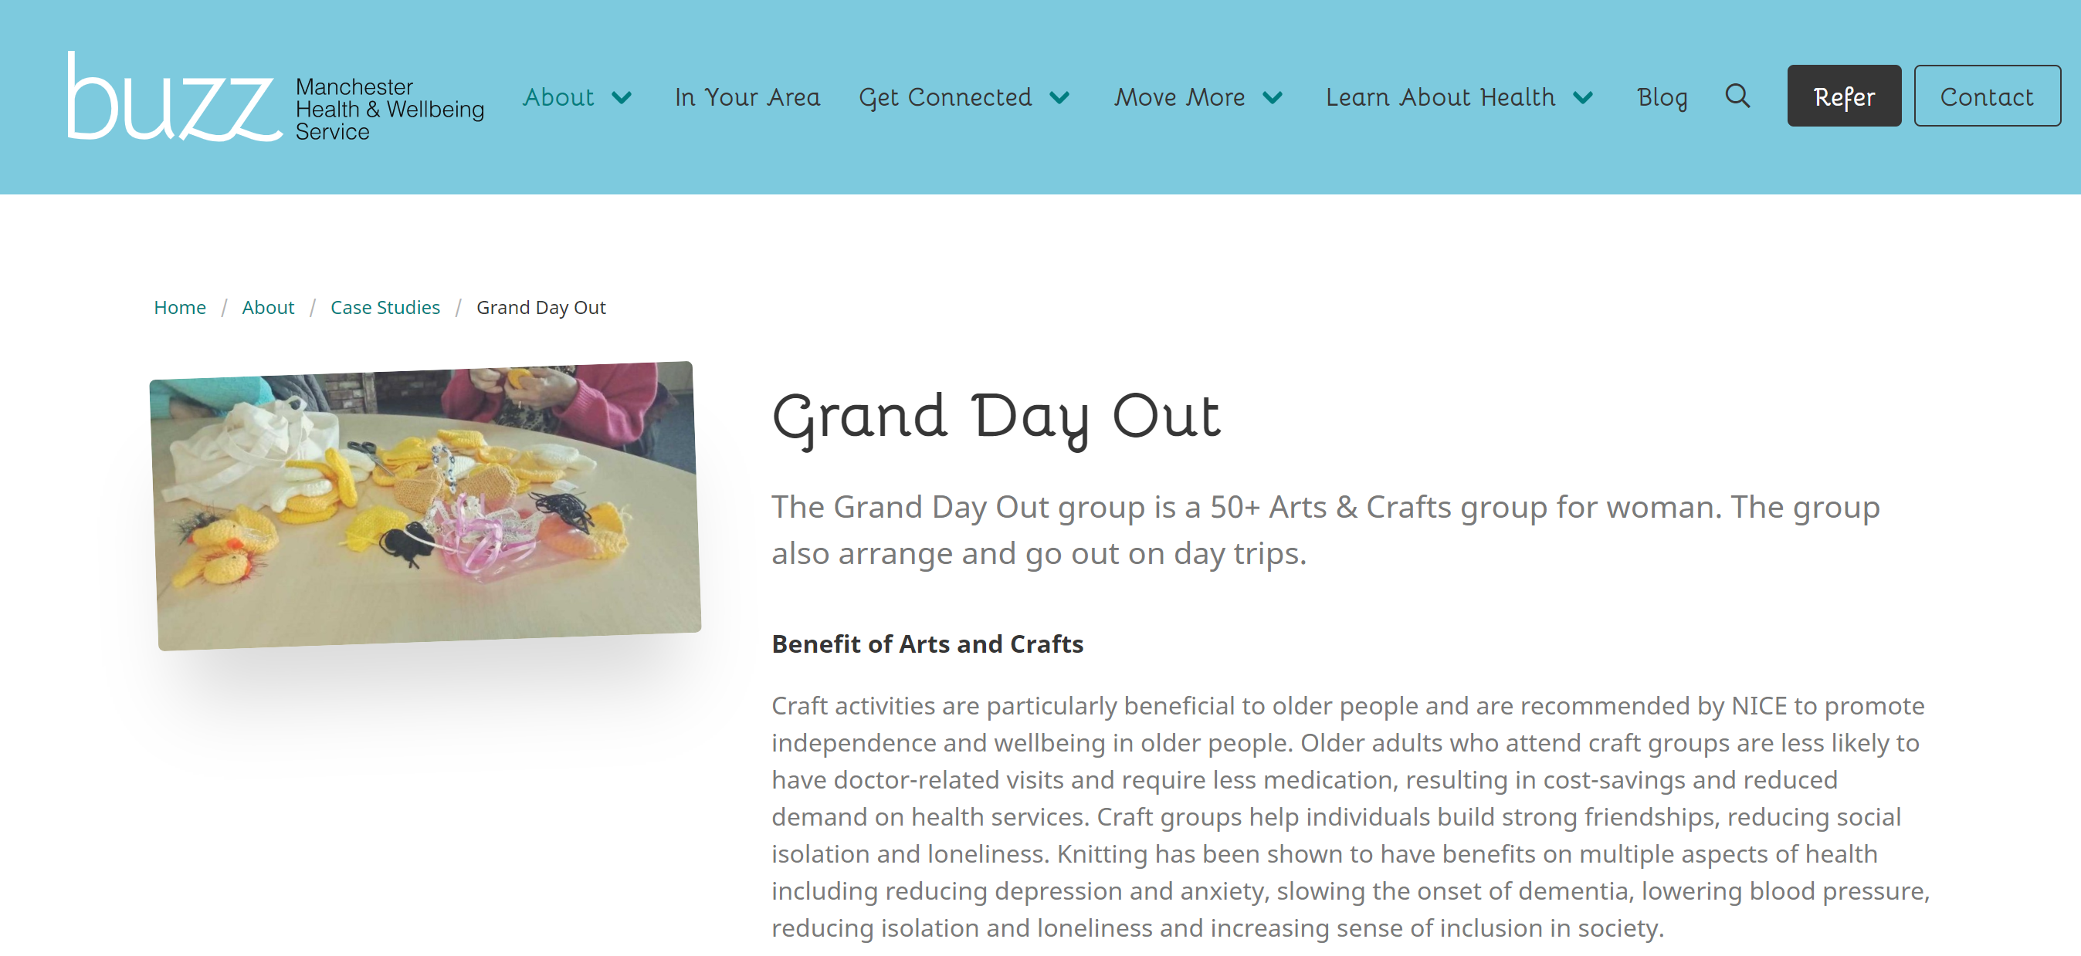

Evidence
of
evidence
Notes:
What difference has it made?
Every project has evidence behind it.
Visible in case studies on website.
CDM adapted project report template to include a benefits, research and policies section – evidence is valued
Views on evidence – more likely to ask for evidence at beginning of project

Slide 11
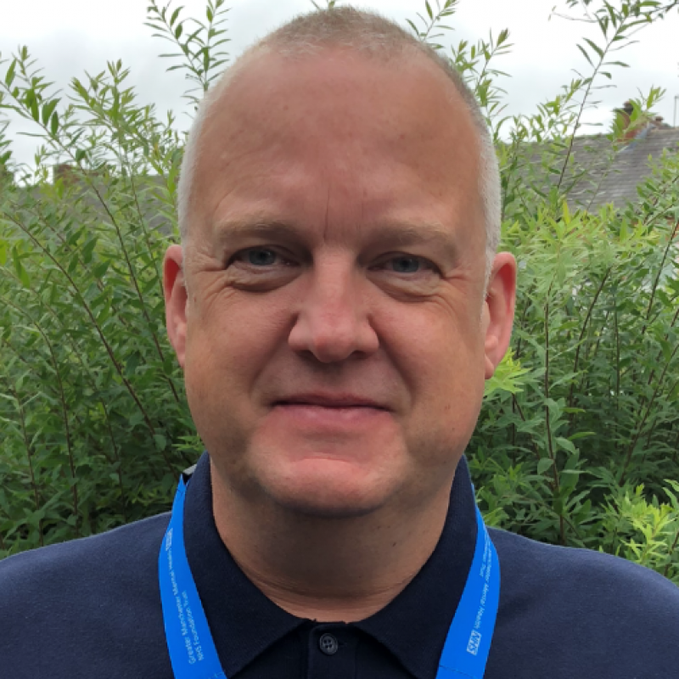
“This work was carried out quickly and in great detail and ensures that the projects we develop and case studies we write are explicitly linked to important guidance which allows key stakeholders, including commissioners, to see that we are fulfilling the criteria set out in our service specification.”
Rick Plant
Community Development Manager

Slide 12
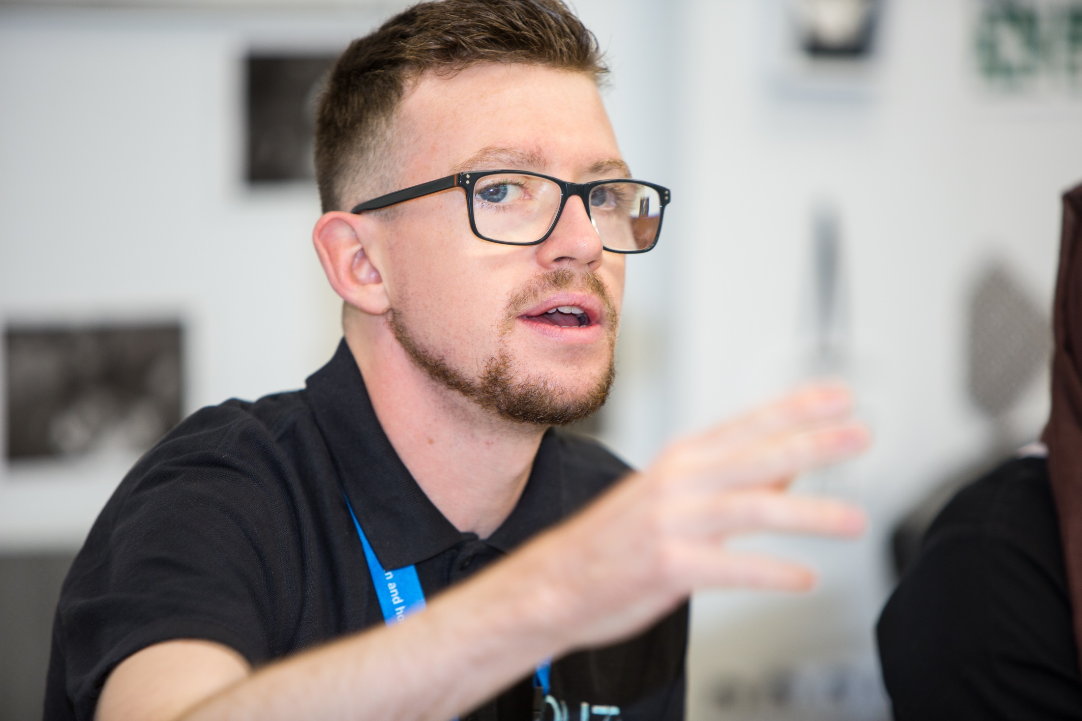
“The immediate access to physical and online resources, helps us to ensure that our work is underpinned by the latest health evidence. This means that residents, service users and our communities can have the utmost confidence in our work.”
Ben Talbot
Neighbourhood Health Worker

Slide 13
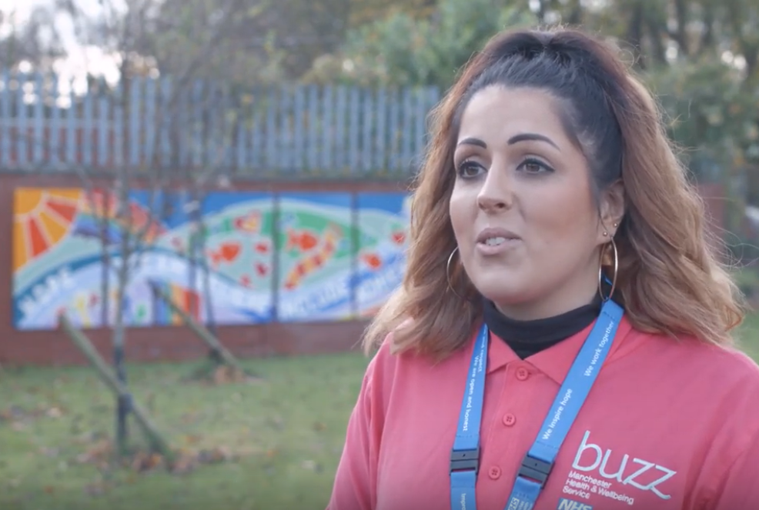
“I often work with community groups and partner organisations to support them when they are applying for funding. Having access to the project evidence summaries from a trusted and reliable source such as the Library and Knowledge Service helps me to deliver my role in a strong and effective way and enables me to support the development of neighbourhoods within the City of Manchester.”
Yasmin Holgeth
Neighbourhood Health Worker

Slide 14
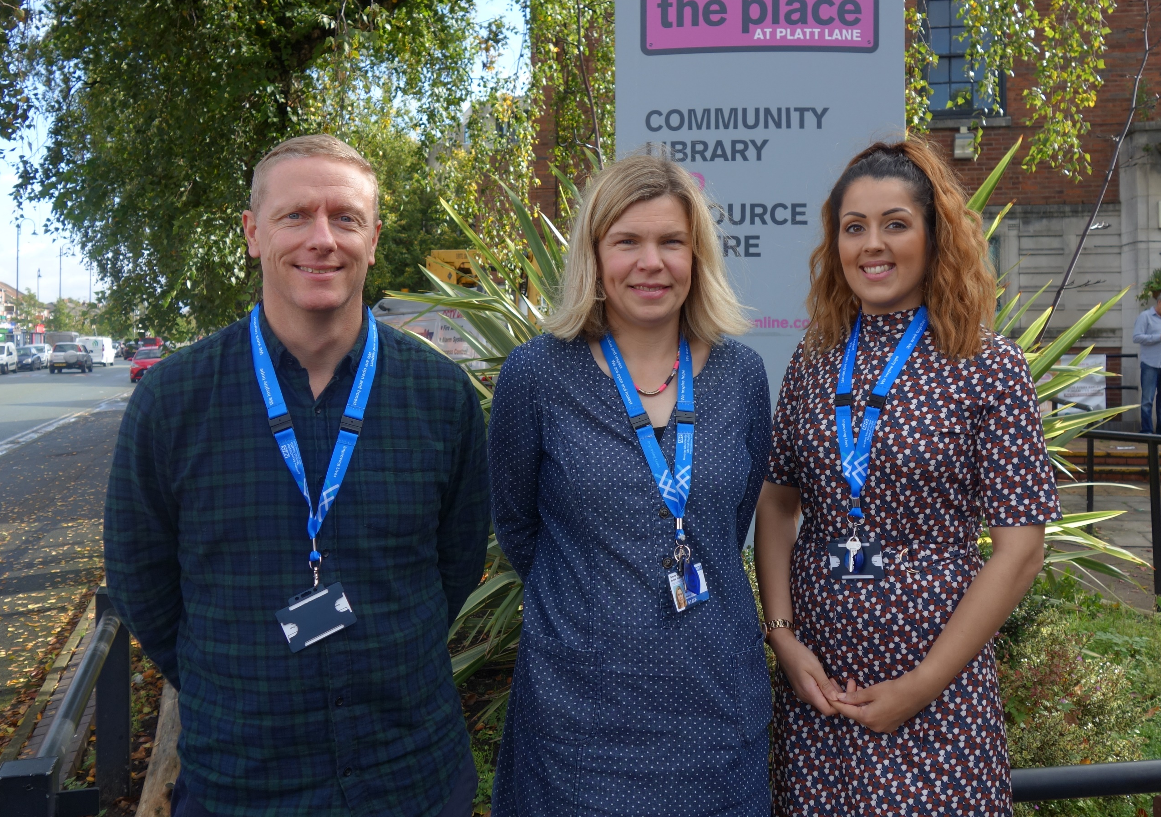
Evidence from the start
“Recent work has been focused on the impact of Covid-19 on the mental health of older people. I was able to use the key points raised in the evidence summaries within discussions about the best ways to engage with the older population, with the aim of more older people accessing psychological support.”
Simon Kitchin, Neighbourhood Health Worker
Notes:
How do we want to build on this?
Currently being used – will review them in a year’s time to check it’s fit for purpose.
Want evidence to be consulted at the start
Since the summaries, he has asked for more
Focus groups on engaging with older people around their mental health

Slide 15
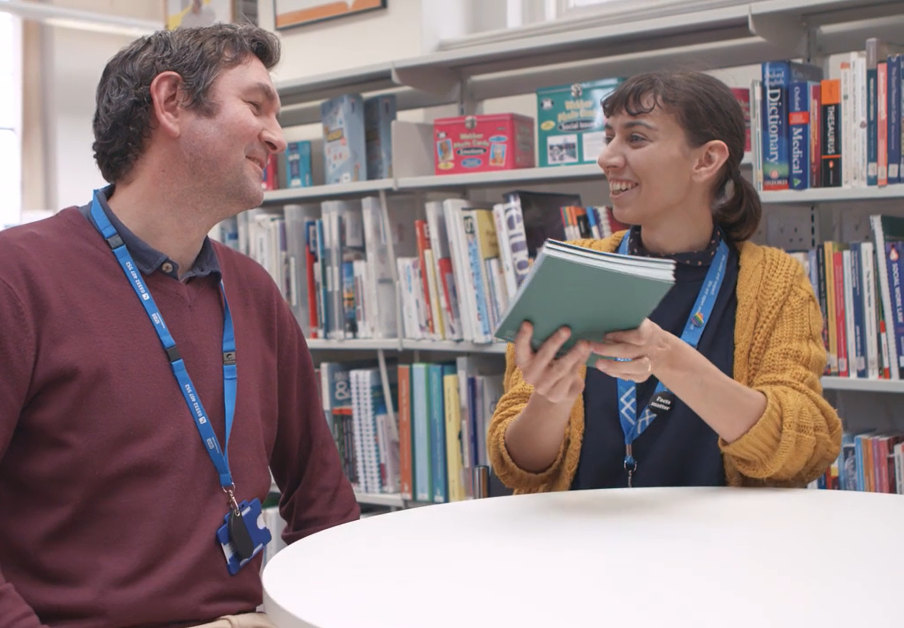
Training
Notes:
NHWs skills to look for evidence themselves
For their specific needs

Slide 16
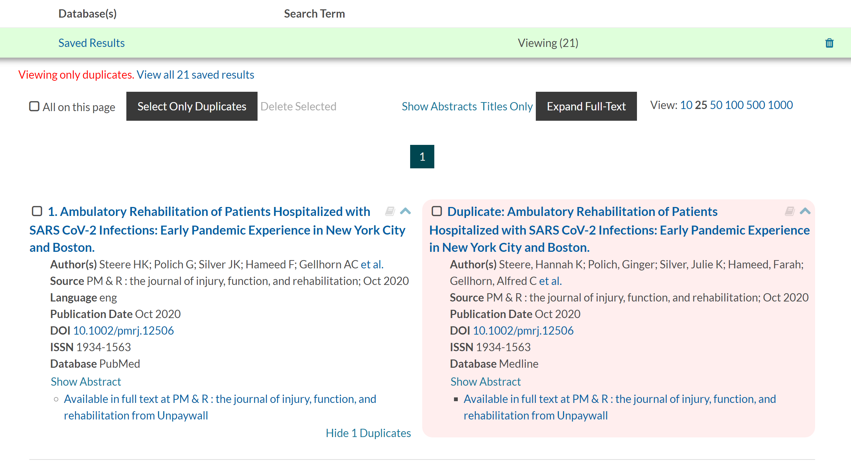
Duplication …
Notes:
Use as a blueprint for working with MHCC
Business case for new services to be commissioned
Lit search included in same way it’s in project report template
Talks have taken place – halted due to COVID
Learning from this project can be applied

Slide 17
Thank you
Any questions?

