Slide 1

Seasonal Reflections
David Stewart
Head of NHS Library and Knowledge Services North
Notes:
Christmas in Warrington

Slide 2

Notes:
Nightingales
Alerts
Web pages
Redeployments
Amazing flexibility of all staff in very challenging times

Slide 3
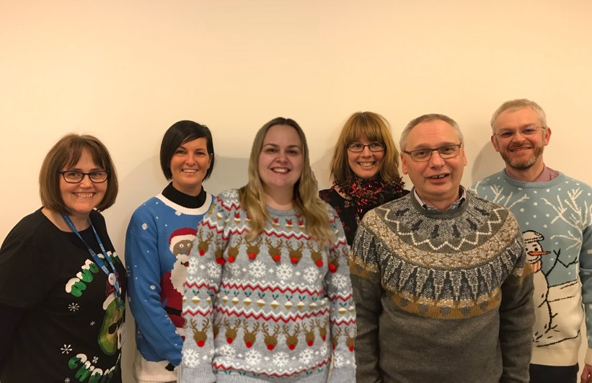
The Team

Slide 4

Knowledge for Healthcare
2021 - 2026
Notes:
Due for publication 2nd or 3rd week of January 2021

Slide 5

Notes:
Value proposition
Space
Psychological support for embedded librarians
Thinking about your quality and improvement outcomes framework (new dates announced?)

Slide 6


Slide 7


