Slide 1


Moodle for Organisational Change & Learning
East Cheshire NHS Trust
Macclesfield

Slide 2

Background
Organisational Development
Library
2018/19 – library involved in an OD project to develop a Cheshire & Wirral System Leadership portal.
2019 – we helped the OD team trial a Moodle platform.
End 2019 – OD team commissioned the creation of a Moodle platform, but didn’t have the capacity to start developing it.
2019 – Library staff start to develop a website to share innovations and best practice from across the trust.
2020 – COVID … help, everything needs to be online! Library asked if we could support Moodle…
Notes:
We supported previous OD projects and they recognised the skills of the library team.
Parallel to this Holly had the idea of creating a best practice portal for staff to share their innovations across the organisation, and wider.

Slide 3
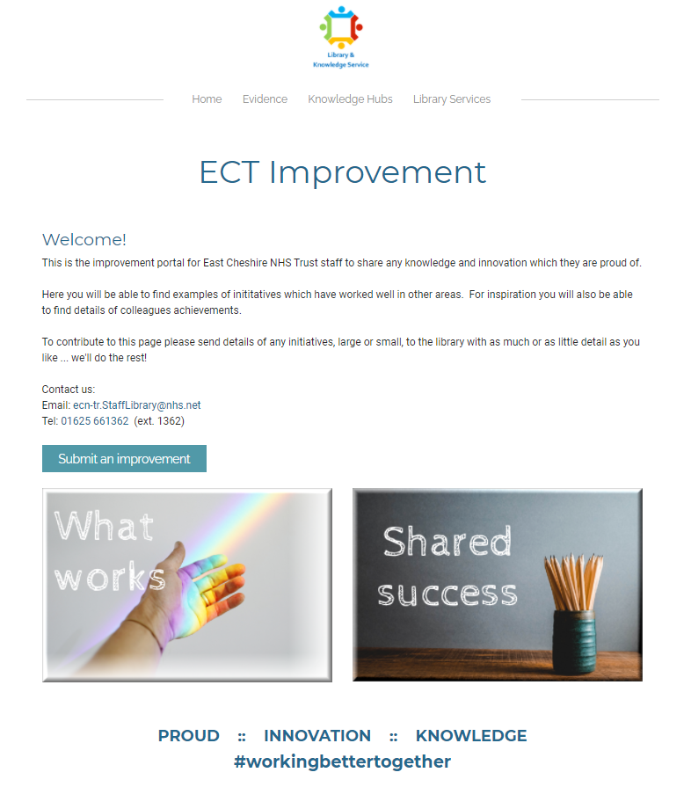
Why we got involved
We quickly identified the potential for incorporating our ‘Best Practice Portal’ and KM tools into the courses, and how we could use the opportunity to embed the library into teaching and learning.
It was a key project and we saw potential for us from integrated working with other teams on an organisation-wide project.
Notes:
Working on previous projects with the OD team had showcased our skills and highlighted what we can do. Without the library staff the project would have struggled to get off the ground, and wouldn't have included all the KM content and library resources.

Slide 4
What has the library achieved so far?
The eResources Librarian has been working closely with the OD team to build the platform and courses from scratch, developing the site to deliver the first courses. We provided the key system development support.
Started to develop the ‘Knowledge Hub’ area of the site, which will include the ‘Best Practice Portal’ and information on KM tools.
We've been able to ensure library resources and support are included in every course created, including reading lists with embedded links to resources.
Each course has an embedded discussion area for staff to share ideas and thoughts, to develop Communities of Practice.

Slide 5

Risks & Barriers
We considered the risks to be higher if we didn’t get involved in the project. This would have demonstrated a lack of flexibility and unwillingness to work on an important project. It would also have stopped us from showcasing our skills, demonstrating our worth to the Trust and put up barriers for potential future working.
Covid was our friend – it broke down traditional barriers & gave us more freedom to just get things done.
Covid was our enemy - all teaching has been suspended part way through our test phase.

Slide 6
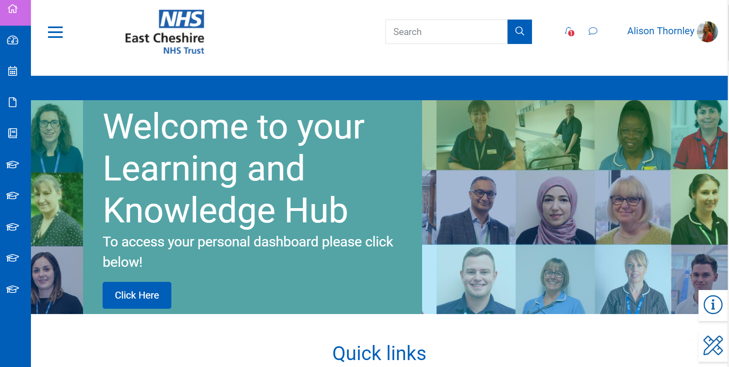
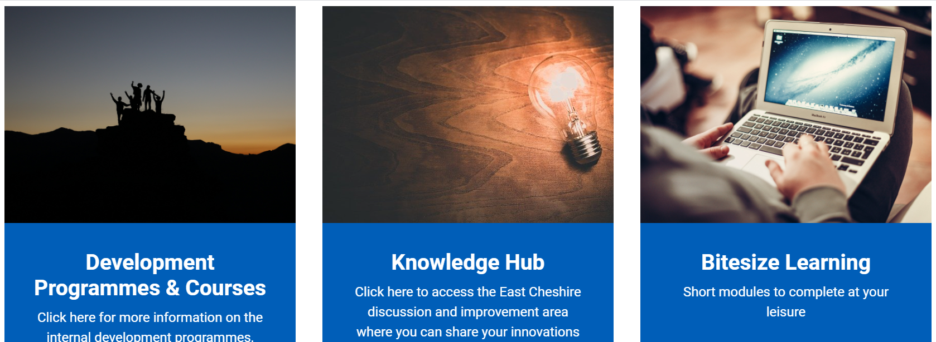
Notes:
Home page – got name changed to include 'Knowledge' as well as Learning.
Site includes taught courses, the Knowledge hub, and internal 'bitesize' e-learning courses.

Slide 7
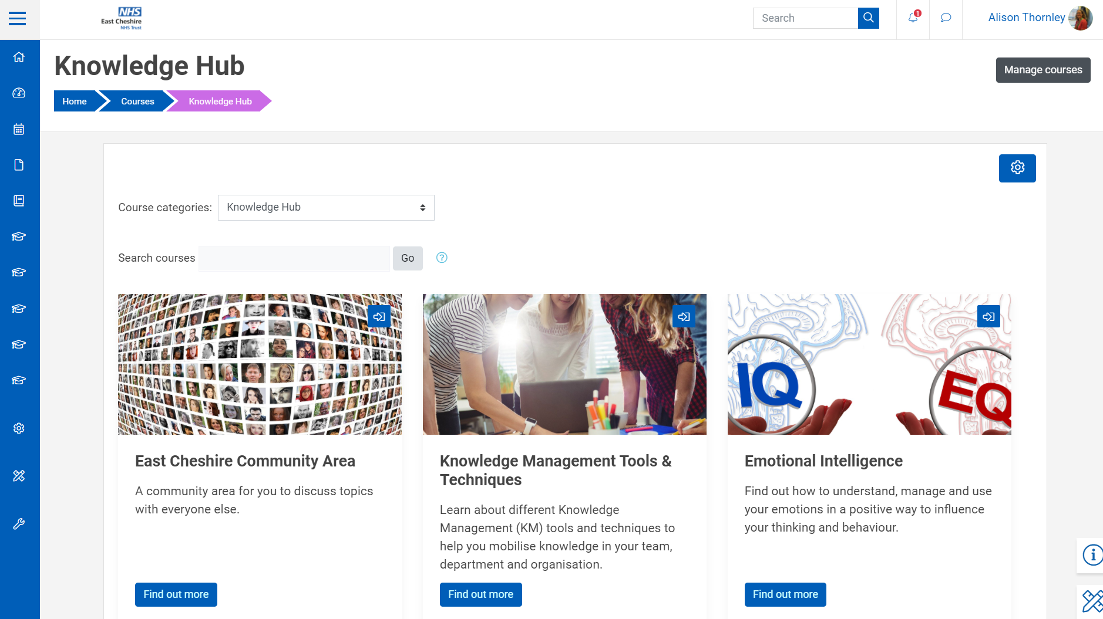
Notes:
The 'Knowledge Hub' is where we are going to develop the best practice portal, share knowledge assets and other evidence-based resources.

Slide 8
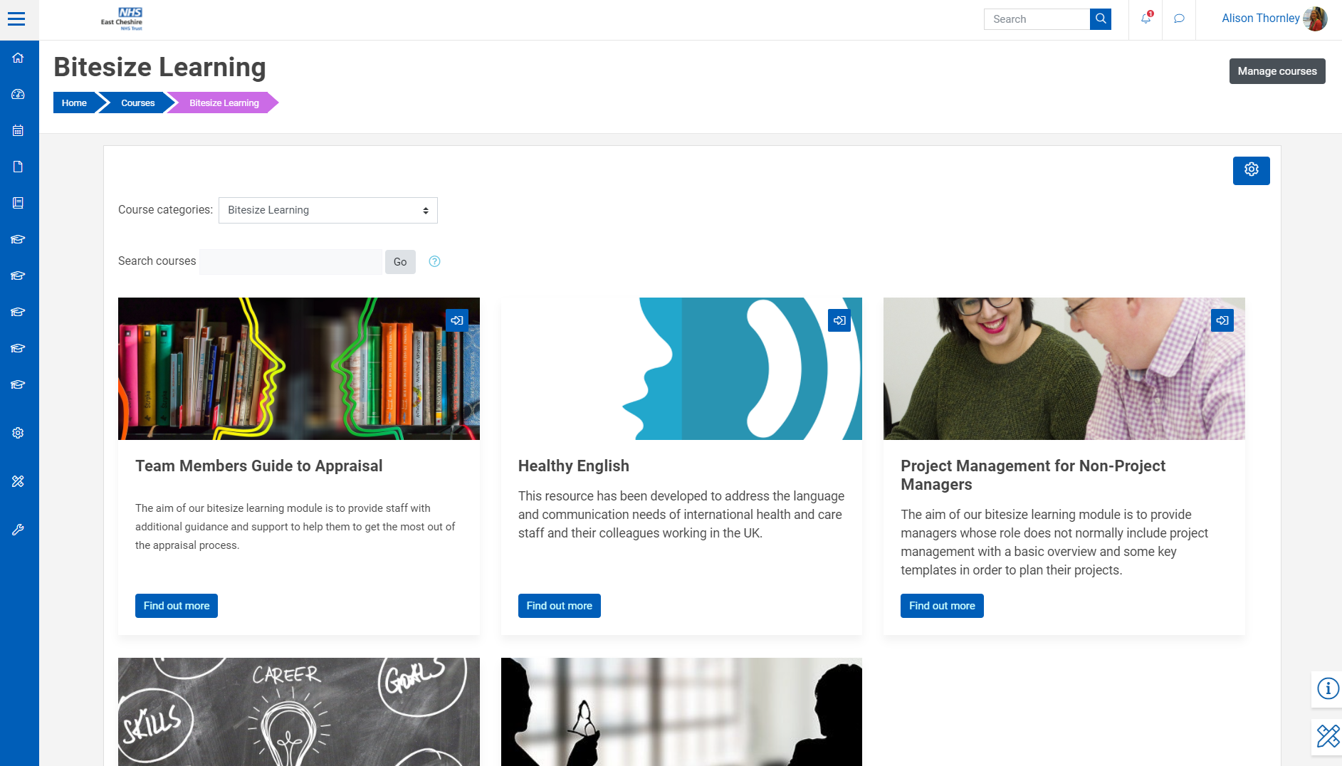
Notes:
New local e-learning content is being created to support trust priorities

Slide 9
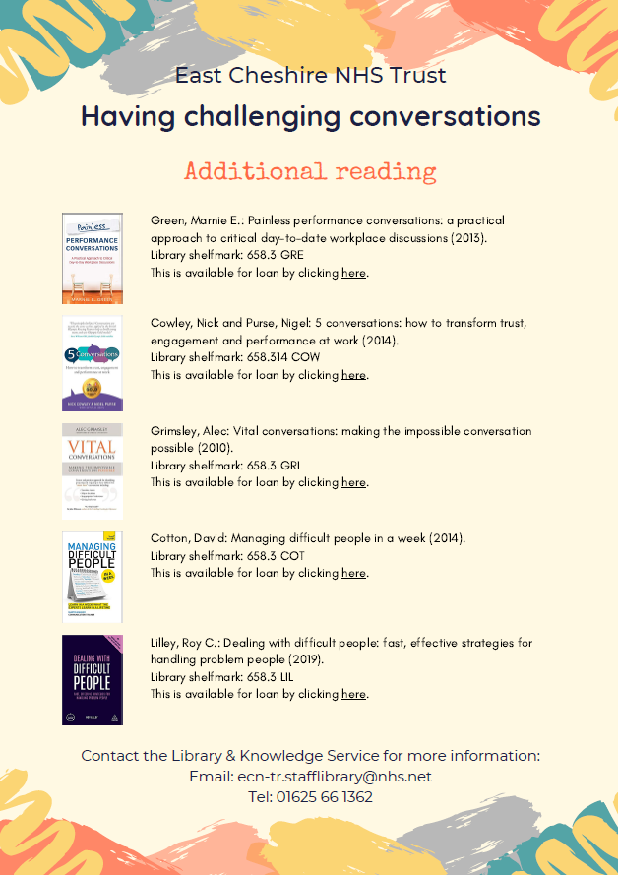
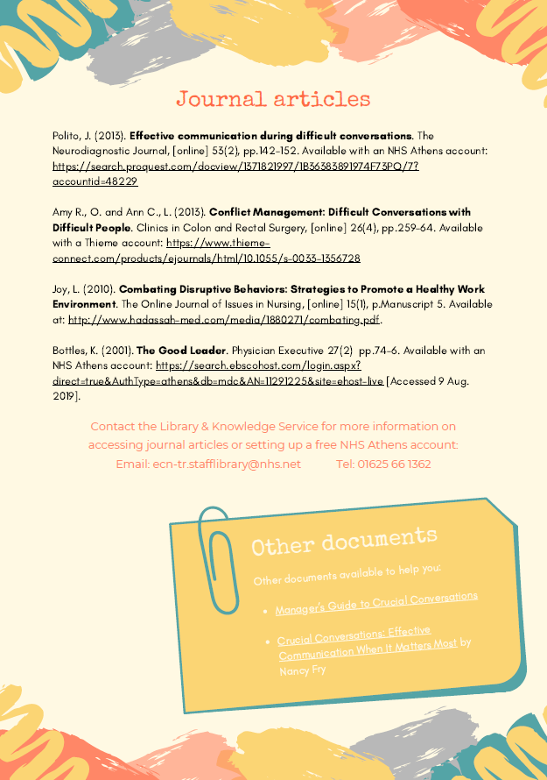

Slide 10

What would have happened without us?
Probably nothing!

Slide 11
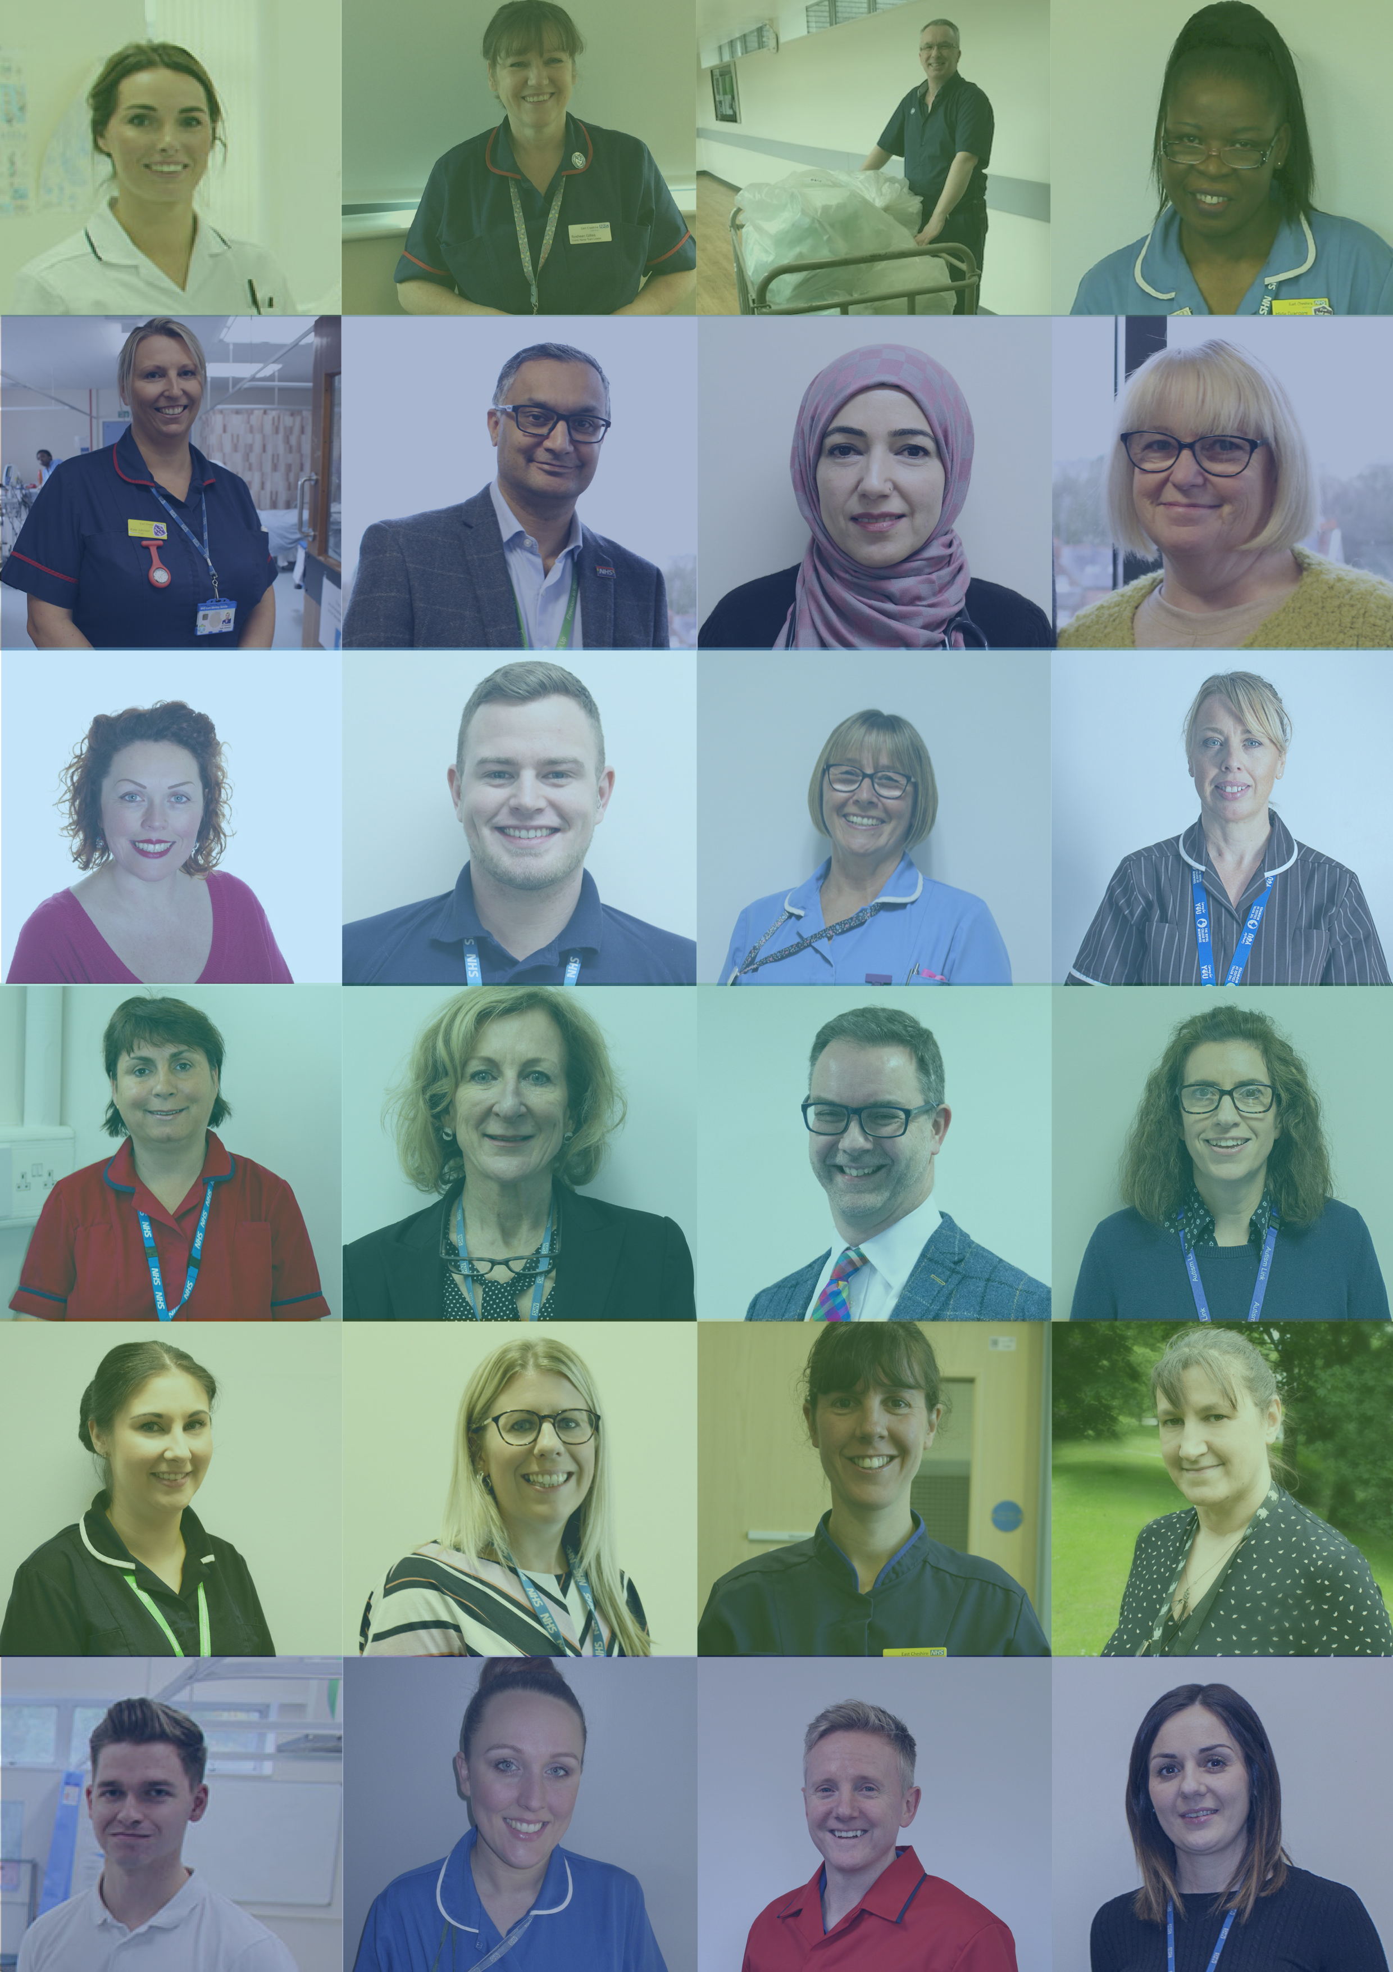
What impact has it had for the library?
It has enabled us to showcase our skills and expertise, improving the reputation of the library.
Working on an integrated project with other teams.
Involved in a core organisational project – enabling delivery of high priority training.
Integrated the library into courses.
Highlighted the value and skills of the library to senior managers and the Board.

Slide 12

What impact will it have for the organisation?
The 'Learning & Knowledge Hub' is integral to the delivery of virtual teaching and organisational development. It is part of the current high priority wellbeing support, with courses such as emotional resilience.
Encouraging and enabling the integration of KM tools into learning in a more formal way, which was something the trust wanted to improve.
Development of a variety of Communities of Practice.

Slide 13
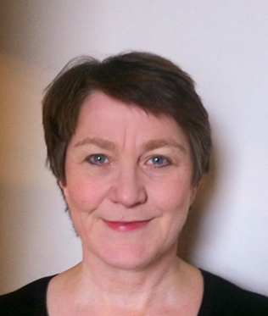
Emma – OD Manager
"Working in collaboration with the Library and Knowledge Service here at East Cheshire NHS Trust has provided us with the ability to build an agile learning platform for our staff in a very efficient and effective manner. Bringing together their skills and abilities of the technological elements to our educational offering has enabled the production of our Learning and Knowledge Hub in a very timely manner to support our frontline staff during this particularly difficult time."

Slide 14

What have we learnt?
Learnt a new IT system
Time management
Negotiation and influencing skills
Improved our ability to "sell ourselves" and our skills
Notes:
1. We had no experience with using Moodle so had to learn it from scratch in a short space of time.
2. There was no additional funding for extra hours; needed good time management skills to get the day job done alongside the project.
3. Negotiation to get our priorities (KM tools, integrated reading lists, best practice portal etc) included within the central project; negotiation to maintain a balance with our normal jobs as Moodle could have taken up all our time.

Slide 15

Where next?
This is only the beginning!
In 2021 we are (Covid-permitting!) finalising our testing phase and rolling out across the organisation.
Developing and promoting the Best Practice and community of practice areas.
Engaging course leaders with more formal KM techniques, aiming to implement at least one KM tool within each course.
Creation of a monthly 'hot topic'
  evidence synthesis /
  Knowledge Asset.

