Slide 1

Using Read QXMD for current awareness bulletins
Notes:
Hello – I'm Patrick Glaister the Clinical Librarian at ELHT. I want to talk about a service development that has had a massive impact at ELHT – it has saved staff time, it has streamlined processes, engaged with clinical staff and has helped embedevidence based practice into the organisation

Slide 2
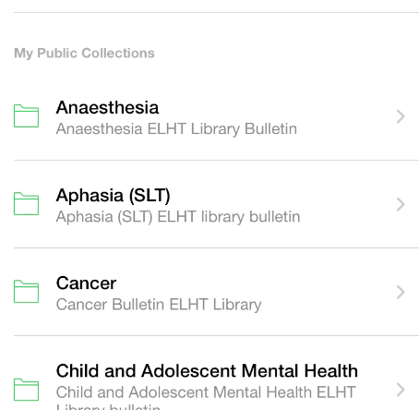
Why did we start using Read QXMD
Notes:
We had been producing current awareness bulletins for about a year by March 2020. Thes bulletins were popular but proved time consuming for staff – we had 7 members of staff producing around 50 bulletins on a bi-monthly basis in a variety of subjects. But we were never sure if people found them useful or engaged wit the bulletins.
We produced them by searching databases such as CINAHL, MEDLINE, EMBASE, PUBMED usually by setting up alerts. We also made some by following individual journals via Electronic table of contents.
This was then copied and pasted into a word document - (Which involved lots of reformatting etc)
It took a long time.
By around June this year we were struggling and we had not produced a normal bulletin for around 3 months
We had redeployed within the hospital to help with fit mask testing and other staff off sick.
As COVID took hold we also started having requests for COVID-19 bulletins in various areas – Paediatrics, Emergency Medicine, Critical Care and Vaccination. These took a long time to produce using the old system. So it was time to start looking at better ways of working and producing bulletins more efficiently.

Slide 3
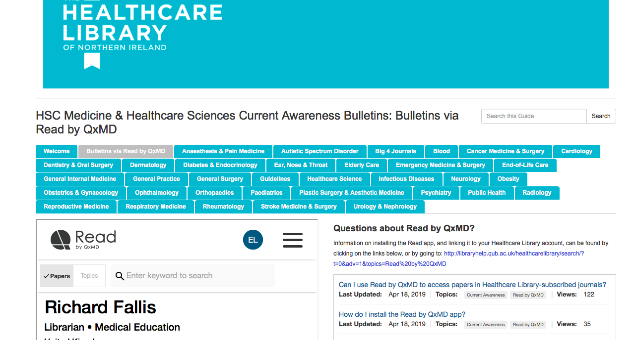
Notes:
https://libguides.qub.ac.uk/healthcarelibrary/medicinebulletins/readbyqxmd
This is when I came across this excellent page done by Richard Fallis in the Healthcare Library of Northern Ireland. He was using ReadQXMD to make his bulletins. I downloaded the APP and started playing around with it. I also contacted Richard and asked for advice. He was very helpful and I ended up signing up for an institutional account with Read QXMD.

Slide 4
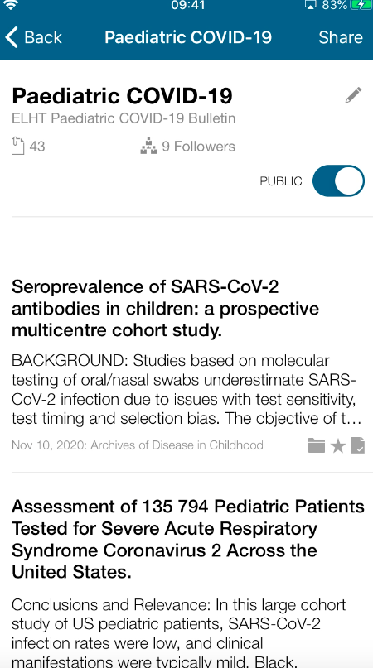
Pilot bulletins
I enjoyed the new system quick and intuitive
​ ​
Paediatric Consultant (Covid-19 bulletin)
That looks great, thank you for all your help
Speech and language therapist
Notes:
ReadQXMD were very helpful and integrated our owned resources within ReadQXMD to make the process seamless for our users when they would click on a bulletin.
I started to pilot new style bulletins in a number of areas. As I was in constant contact with consultants in Emergency Medicine, Critical Care and Paediatrics over their COVID-19 bulletins I first piloted them in these areas.
I found it was so much quicker for me to compile bulletins, a job that involved me working on two pcs for about 4-6 hours a bulletin was now taking around 1 hour (after the initial set up).
Feedback from this pilot was good

Slide 5
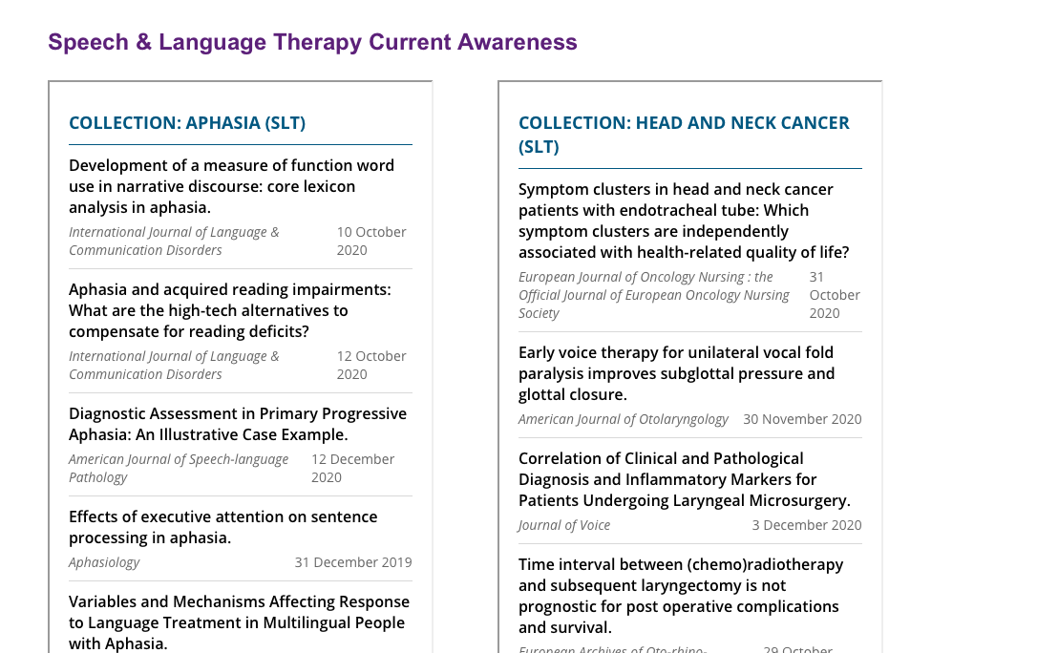
Notes:
After the success of these first bulletins on COVID I got in touch with the Speech and Language team who were very keen on current awareness and we worked together using QXMD to produce a bulletin after looking at this we decided on making 6 separate collections – this involved setting up key word and phrase searching on Read QXMD http://www.ehub.elht.nhs.uk/slt-cab.html (show website)
This relationship we had with the consultants from the various departments for COVID-19 and with the Speech and Langauge department was something I wanted to develop in all the different specialities

Slide 6


Liaison with clinical staff
Notes:
The next stage was liaising with all the clinical staff to design their bulletins. Emails went out to all the people who had signed up for the current awareness bulletins and also list of different departments were emailed too.
Basically we wanted them to be involved with the project and shape their bulletins – lots of staff replied and we met over teams or in person and worked discussed key journals and phrases to look for, then set up the bulletins together on ReadQXMD. This contact was an excellent outreach opportunity and resulted in training booking, journal clubs and increased literature searching.

Slide 7
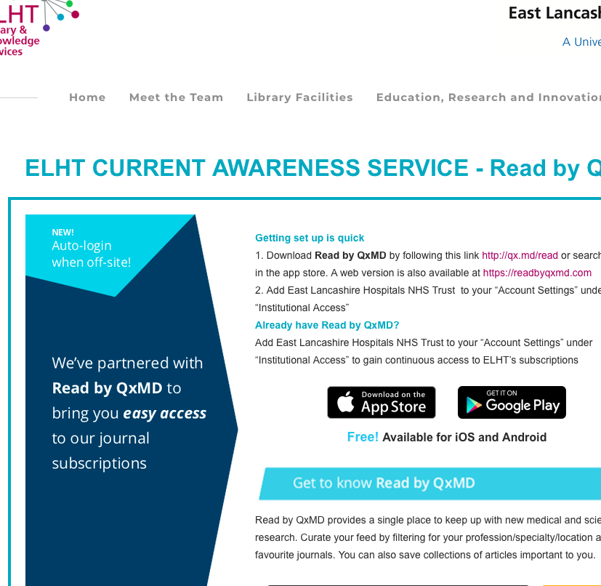
Development of website
Notes:
Now it was time to promote these various bulletins and Judith our excellent eresources librarian designed an excellent website promoting the bulletins, using pop ups when people visited the library. Embedding the collections on library pages and doing a great job of making it easy to discover this new service offering.

Slide 8
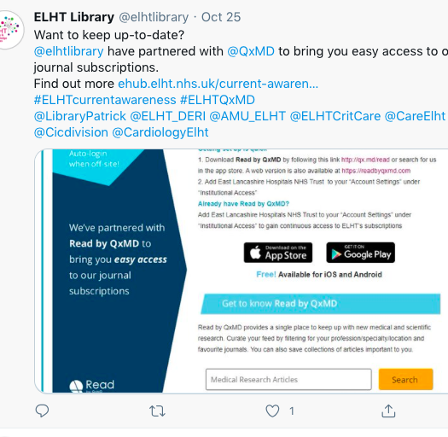
#greatteam
Organising
Promoting
Team work
Notes:
Initially I had taken on the whole production of the bulletins so it was time to get organised and promote it further. This is where Clare Morton our operational service manager helped. I showed her how to do these and she went through and organised the processes, divided up the bulletins and scheduled a marketing programme on twitter which was done by our library officers Sarah Glover, Charlotte Holden and Lauren Kay. It was a real team effort.

Slide 9

Future plans
Links with departments
Collaboration
Training
ELHT Repository
Spread the word
Notes:
For the future we are looking at developing our relationships with departments we are alread in contact with – creating library links/or subject matter experts who help shape the bulletins. We want eventually for the clinicans to collaborate with us and even produce the bulletins themselves in combination with the library
We want to train people up on using these bulletins showing the different features, there is sometimes a reluctance to move away from file versions such as PDF/WORD to a more interactive online approach. To help with this we want to train peopleeither through videos and help guides or face to face/virtual training
One larger project is to create a living collection of our ELHT staffs publications using ReadQXMD, a kind of online archive/repository to showcase work.
Then of course is to promote this like I'm doing now to other colleagues.

Slide 10

Barriers/Issues
Notes:
Of course there will always be issues with changes and there have been a few that we need to iron out
Certain bulletins we used to produce like finance, HR etc might not be covered by QXMD so we may have to look at other ways to produce these or work with QXMD to get particular key journals added
Training – as I alluded to in future plans we need to be able to train people to use the bulletins and make them more confident using these
Proesses – there are still some teething problems with how the APP works in terms of broken links and reporting these. Hopefully by working with QXMD to resolve this and make it easier for users request articles and contact us from the app would be a great solution

Slide 11
Overall effect
Time saved
Positive reaction
Increase in the amount of literature search requests and training
Engage our staff with evidence
Notes:
The use of QXMD has proven to save a lot of time. After the initial set up bulletins can be produced quickly and can be done much easier – you can just sit with your IPAD or phone and create them rather than work on two screens copying nd pasting articles.
We have had some great reactions so far thanking us for our hard work, and user have said it is easy to use and convenient.
We have seen large increases in search requests, article requests and training as a result of QXMD and the initial engagement with evidence.
Hopefully we will see our staff engage more with evidence and use that to inform practice.

