Slide 1

What Changed
April 2020
We received numerous requests for evidence to support strategic change
We identified COVID-19 as an emerging reason for evidence search requests
We recognised the rush to report on Covid-19 might result in poor quality studies
We knew our clinicians and policy makers were under pressure
We wanted to supply synthesised, quality rated evidence

Slide 2
What We Did
We settled on a simplified ‘Three Tier’ evidence scale
We developed a new overview document for search results using an evidence rating system
Search results were synthesized, categorized and awarded a ‘traffic light’ final grade
Green: High Quality Evidence
Amber: Medium Quality Evidence
Red: Lower Quality Evidence

Slide 3
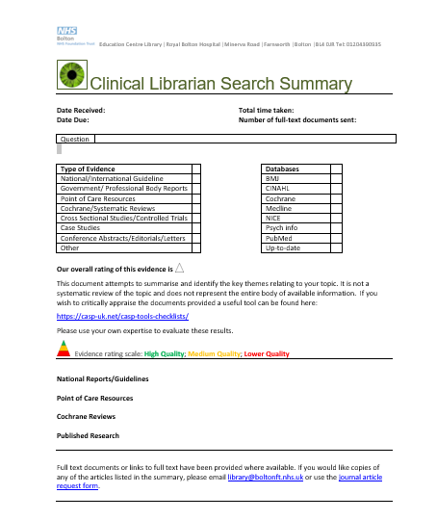
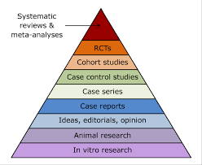
Making It Easy
We provide our own assessment of the quality of the evidence
We base our evaluation on the Hierarchy of Evidence Pyramid
Mostly Systematic Reviews – Green Rating
Mostly Case Studies – Red Rating
We include the usual disclaimers and links to CASP checklists

Slide 4

Results and Feedback
“You are just incredible. The articles are really interesting.
I did not expect your little summary too, which is extremely helpful and concise.”
Community Physiotherapist
Helps focus on the quality of evidence
Provides structured easily digestible results
Saves our busy clinicians time

