Slide 1
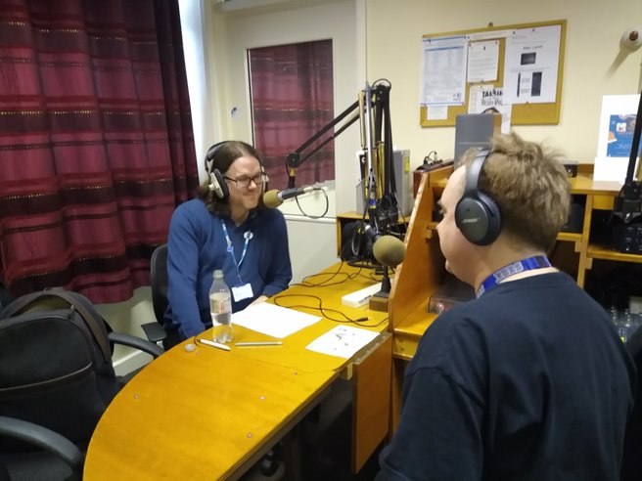
JET Library Takes To The Air
Susan Smith: susan.smith2@mcht.nhs.uk
Heckled by Ben Ridsdale: ben.ridsdale@mcht.nhs.uk
Notes:
Back in time, at the start of the year, when people were allowed to cosy up in small cupboards. The Library started a radio show. An today to complain about it I would like to invite to the library our special guest Ben Ridsdale.

Slide 2

Evolution of the book club
Back in 2018, we had a local author visit.
Our imaginations fired up, with all the possibilities of writers clubs.
But nobody had the time….
Notes:
It all began when we had a local author visit our little Trust book club. Where we had lots of ideas and did nothing.

Slide 3

Then there was Bob & Ben the DJ men
Notes:
Time passed and did nothing, but then one day a chance conversation with the Volunteers Managers we got invited to the Radio Station to meet Bob, who taught us the ways of the DJ and we were sent Ben to actually do the talking and a show began to grow.

Slide 4

Ask and they will come
Budding authors from staff
Crewe Library writing group
Social media requests
https://www.gordondoherty.co.uk/
Notes:
First we asked staff and they came from HR & Maternity, we linked in the writing group from the public library and guests appeared in the studio. Then we ask on social media and I where I discovered people rather embarrassingly that I know more established authors than I thought I did. Gordon wrote a short prequel story for us to his Empire of Bronze series especially for the hospital and recorded it for us.

Slide 5

Barriers
No phone in or way to interact with the audience, and it is difficult to get patients to engage
No method of evaluating the show
Marketing reliant on the support of volunteers or ward staff
Covid – no guest speakers allowed and live radio currently scaled back
Loss of library staff to support the project
I had to read a lot of yoga books

Slide 6

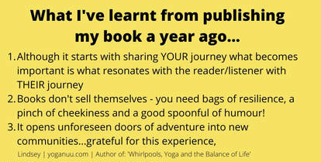
What we learned
Copyright grey area, but publishers have been supportive
Authors generous with time and donations, but can be shy
Always pre-check the books and give guidance for the reading
Home recording aren’t always the best
Donations worth over £25 needed to be declared under conflict of interest - we were the first to test the app
We got permission to share with staff as well as, this meant that some of the recordings could be re-used for mindfulness
https://www.yoganuu.com/

Slide 7

What next?
We are trying to move the show to an evening slot so we can keep it up
Wanting to do short plays and invite staff to take part and do readings
The Trust is keen to get social groups up – 2021 year of the writers group?
Marketing programme for the radio
Expand joint projects e.g. promotion of boredom buster activities for patients
Ben would like to interview you via Teams!!

Slide 8



Yoga through the year recording
Click to play the cloud busting meditation – narrated by Julie Potter from JET Library
Jilly Shipway loved the recording and thought Julie read it well and was sensitive for the need of space. She enjoyed listening to it, so much, she shared it as part of her newsletter and also with her publisher.

