Slide 1

From bright idea to conference presentation
Victoria Treadway @librarianpocket
Notes:
From bright idea to conference presentation
Why should we bother?
What conferences could we submit to?
​​​​​​​ Hints and Tips on presenting at International conferences and non library conferences
What projects / initiatives are we working on we might submit as an abstract? Is there something we could submit jointly?​

Slide 2

Today
Why?
Hints and Tips
What ideas?
What conferences?
​​​​​​
By the end of this session…
Notes:
My reflections

Slide 3
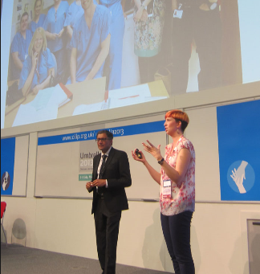
My conference journey ☺
Medical education events
National Association of Clinical Tutors (NACT)
Association for Medical Education in Europe (AMEE)
UK conferences
CILIP
Evidence Live
HLG
British Association of Critical Care Nursing (BACCN)
International conferences
2nd international conference on recent advances in Anaesthesiology (INCRAA)
1st International Conference on Evidence-Based Healthcare
Canadian Healthcare Libraries conference
EAHIL
American Association of Anesthesiologists (ASA)
Notes:
Started with smaller events

Slide 4

Why?
Dissemination
Learn
Advocate
Quality requirements
Opportunity
Professional registration
Develop skills & career
Oh, and it’s fun!
Notes:
Dissemination – impact, knowledge sharing
Engagement – another way to reach an audience
Learn – always pick up something – Prezi in 2012
Quality requirements – knowledge management, demonstrating impact
Opportunity – travel! Other opportunities present themselves – Ged Byrne

Slide 5
What skills?
Abstract writing
Poster design
Film production
Negotiating and influencing
Writing sponsorship applications
Budget management
Presenting
Time management
Reflective writing
Advocacy
Presenting
Report writing
Blogging
Tweeting
Evidence based librarianship
Notes:
Dissemination – impact, knowledge sharing
Quality requirements – knowledge management, demonstrating impact
Develop skills
Opportunity – travel! Other opportunities present themselves – Ged Byrne

Slide 6

Hints and tips
Start small
Buddy up
Be creative
Encourage each other
Notes:
Start small – my first non-library conference was a medical education event. The question I was asked most frequently was “What’s a clinical librarian?” – don’t underestimate the interest of what it is we do!
Collaborate – co-presenting can be a good way to start to build your confidence- buddy up with someone from inside or outside the library – a good way to reach non-library audiences. Co-presenter encouraging me to ditch notes.
Be creative – tell a story about your work. EAHIL patient story.

Slide 7
Let’s talk! #1
What could I/we present?
Service development
Something we do well
TIPS
Think about things you’ve already shared (newsletters, communications, blog posts, award submissions)
Think about things you’ve done individually, as a service, and as a professional group
Notes:
Is there a project you’re involved in that you need to share?
Do you need to engage with a particular audience?

Slide 8
Let’s talk! #2
Where could I/we present?
Library events
Non-library events
TIPS
Don’t be limited to “conferences”
Use Google!

Slide 9
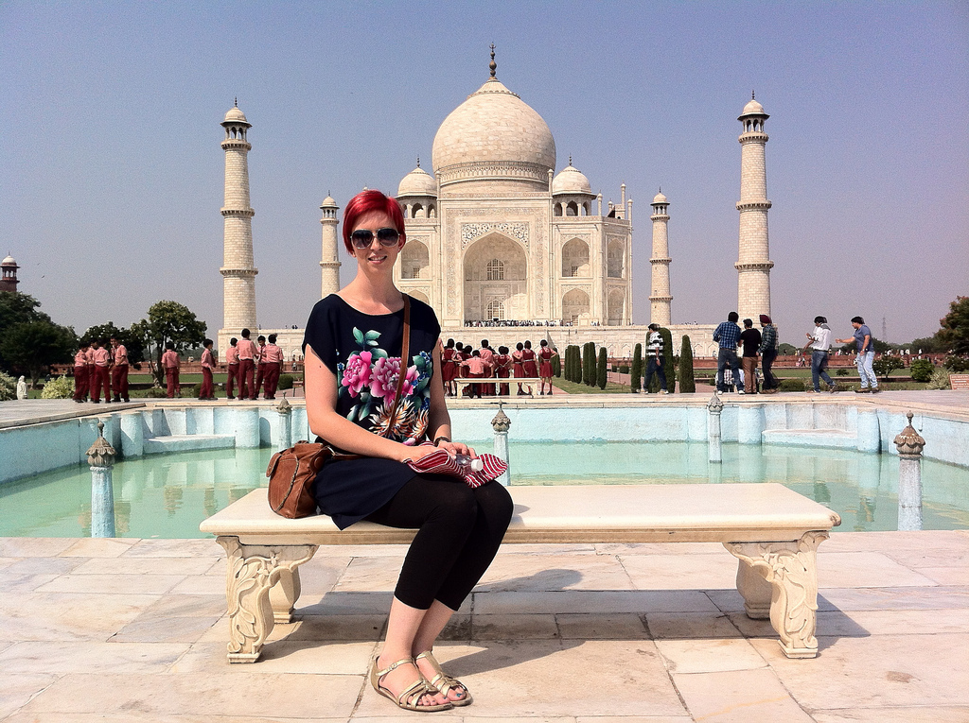
What next?

