Slide 1

Harnessing Twitter for professional development
Victoria Treadway @librarianpocket

Slide 2

Today
Why Twitter?
How?
Get started
Find out more
Notes:
I’m talking about Twitter for yourself, not library service

Slide 3
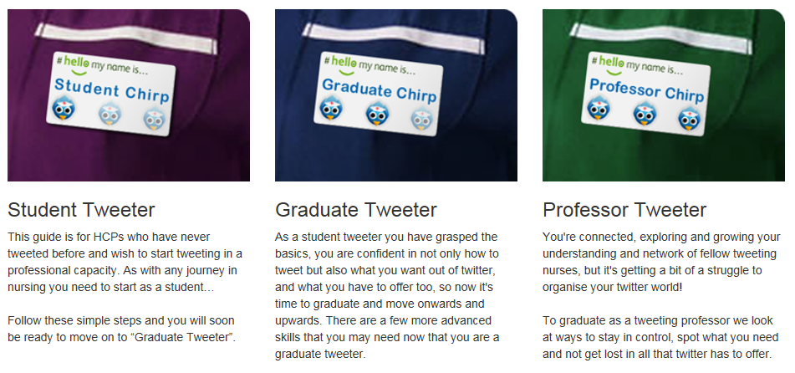

Slide 4
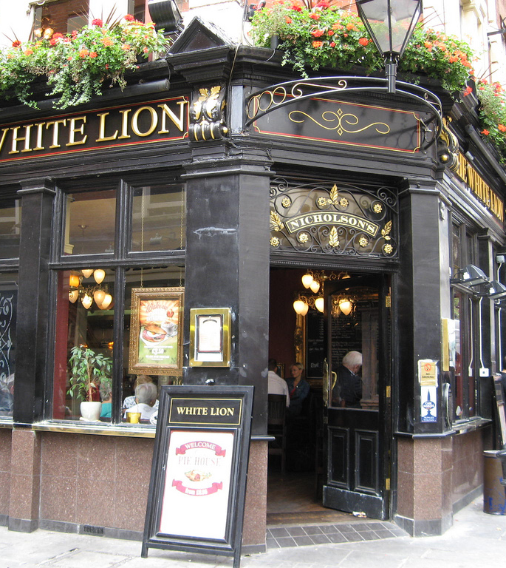
Why Twitter?
Learn
Share
Influence
Be poised
Be ubiquitous
Be agile
Be visible
Notes:
These are some of the reasons I use Twitter
Professional registration!

Slide 5

How?
Tweet
Reply
Chat
Lurk
Notes:
People use Twitter in different ways – all of these contribute to your prof dev
Use it in a way that suits you – and your needs may change
Use it for professional or personal – or both

Slide 6

How has Twitter enhanced your professional development?

Slide 7
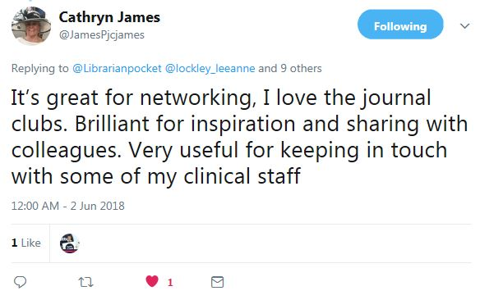
Notes:
Clinical Librarian at Derby

Slide 8
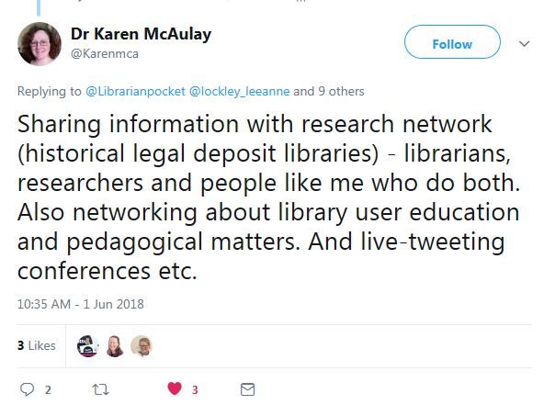
Notes:
Music librarian

Slide 9
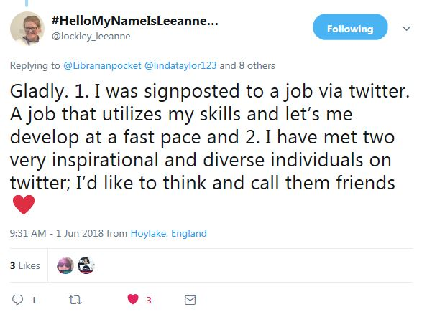
Notes:
Nurse

Slide 10
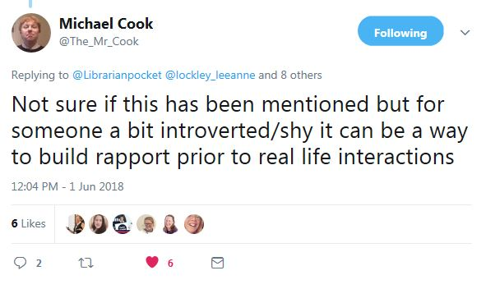
Notes:
PHE Knowledge and Evidence Specialist

Slide 11
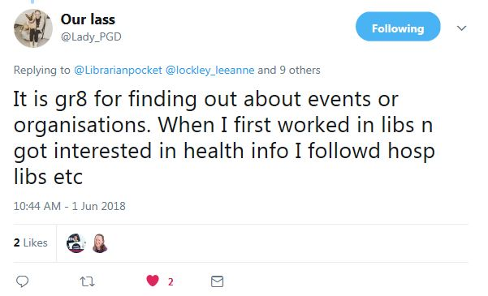
Notes:
Librarian

Slide 12
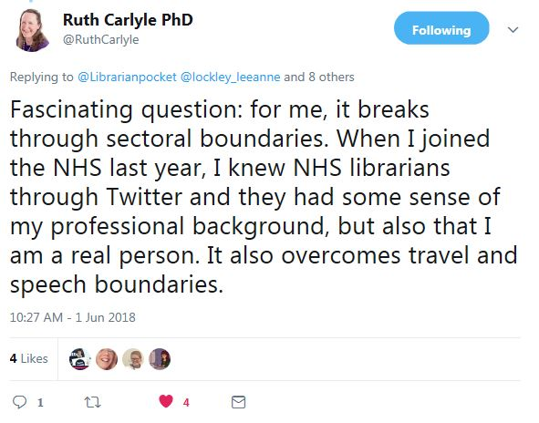
Notes:
Head of LKS Midlands and East

Slide 13
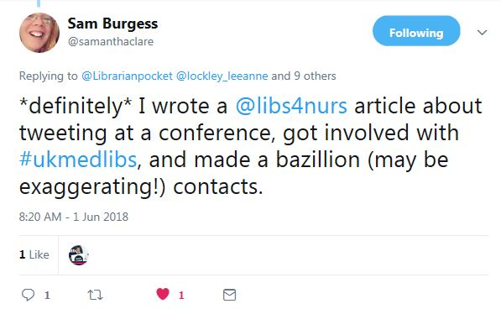

Slide 14
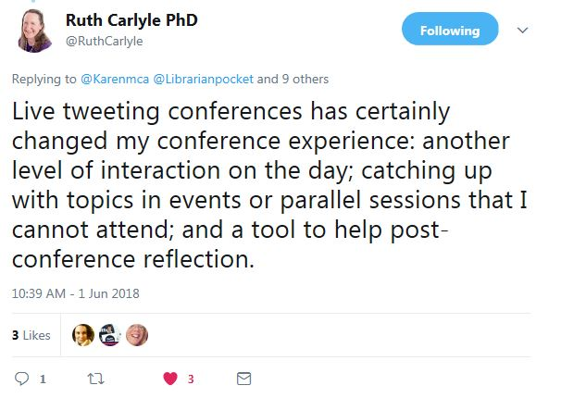

Slide 15
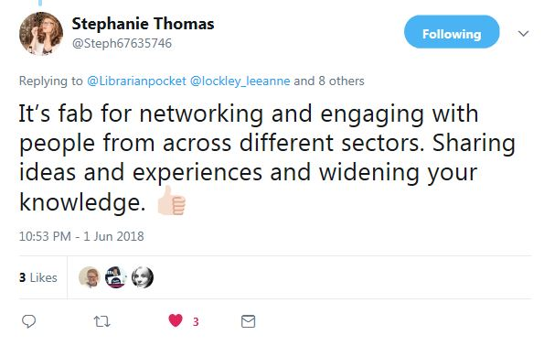
Notes:
Leadershiop and OD manager

Slide 16
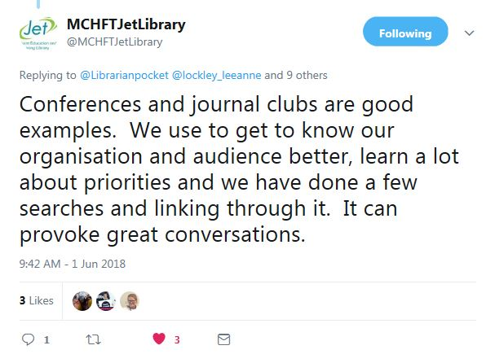
Notes:
Susan Smith

Slide 17
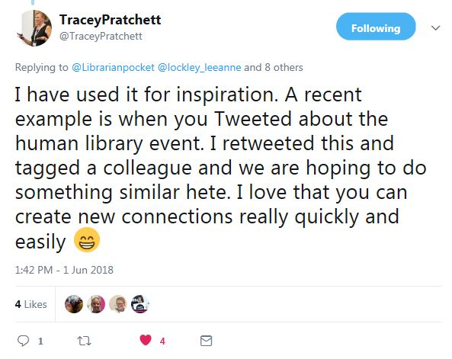

Slide 18
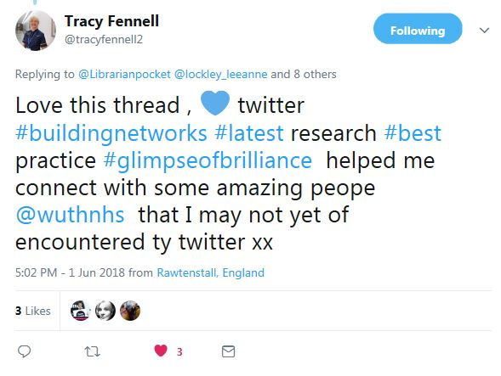
Notes:
Deputy Director of Nursing

Slide 19
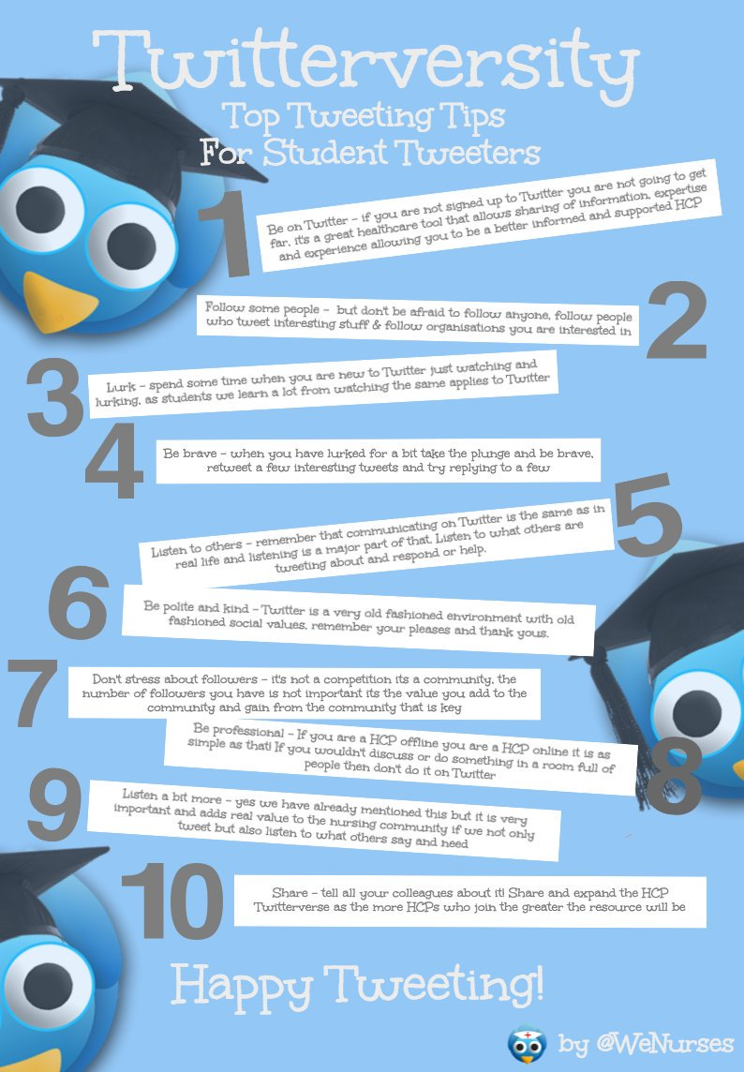
Get started
Who to follow?
People in your organisation
Libraries / librarians
Organisations (King’s Fund, CILIP)
Create account
Follow some people
Lurk until you feel brave
Follow hashtags
Use lists
Compose carefully!
Notes:
Hashtags pull users together by topic
Twitter describes lists, as “A list is a curated group of Twitter users. You can create your own lists or subscribe to lists created by others. Viewing a list timeline will show you a stream of Tweets from only the users on that list.”

Slide 20
Look out for…
@OrkneyLibrary
@LivUniLibrary
@wshlibrary (Fred the Skeleton)
@UKMedLibs and #ukmedlibs
@uklibchat and #uklibchat
@GrumpySkeletor*
@Awfullibbooks (Awful Library Books)
*Parody account (language warning!)
Notes:
Fred the Skeleton lives at West Suffolk NHS Trust
Grumpy skeletor parody account

Slide 21

“Twitter is like a river that its constantly flowing.
Every so often just go and have a look at your Home page stream of Tweets and see what’s going on.
Remember that as with a river you can dip in and out and don’t worry about missing stuff because if its important it will be like a huge flotilla making its way down the river and you wont miss it!!!”
WeCommunities Twitterversity
http://wecommunities.org/resources/twitterversity3
Notes:
These are some of the reasons I use Twitter
Twitter feed gets tailored

Slide 22
Find out more
Twitterversity – We Communities http://wecommunities.org/resources/twitterversity
Article: Tweeting at #HLG2014, by Sam Burgess https://archive.cilip.org.uk/sites/default/files/media/document/2017/lfn-bulletin-2014-vol34-iss2.pdf
Blog post: Using Twitter to be a better librarian, Victoria Treadway https://librarianinmypocket.wordpress.com/2015/11/26/using-twitter-to-be-a-better-librarian/

