Slide 1


It started with a list!
Kieran Lamb
SHH01 - LGF

Slide 2
Outline
Outline
Mailchimp
Mailchimp Workflow
Creating a List
Creating a Signup Form
Designing the Mail Out
Is anyone using it?
Twitter
Facebook
GOAL
Gain an understanding of the flow of mailchimp mail production and to look at the options for social media security settings.
Social Media Security

Slide 3
Mailchimp Workflow
Need for Mail
Who is it for?
Create Sign Up form
Create List
Design Content
Route
Do you have a feed?
Manual
Design Mail Blocks and add content
Time to send? Social Media?
Start Campaign
Test Mail
Design Mail Blocks and start feed!
Monitor Use

Slide 4
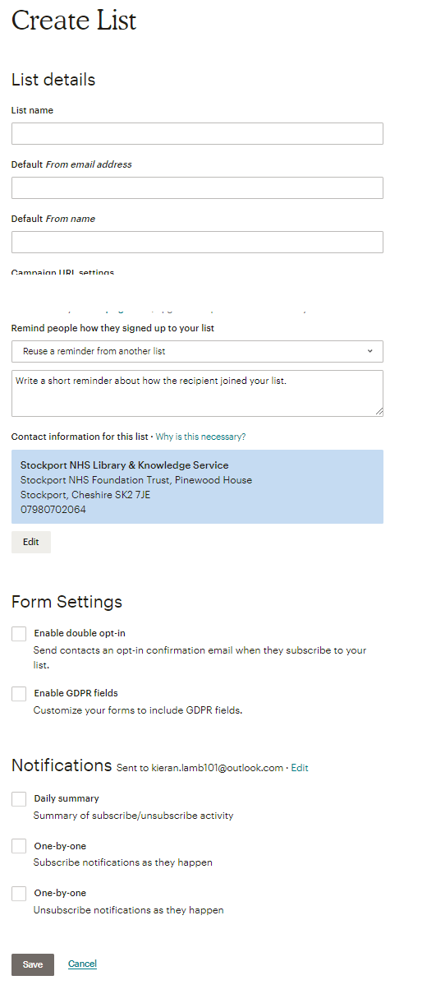
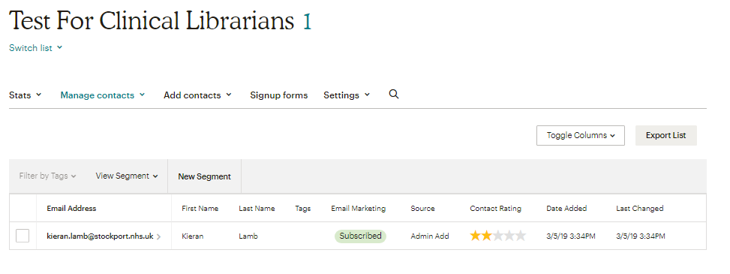
Creating a List – Who’s It For?
Key Things
List Name – make it make sense
Tags – may help with segmentation
Email address and Name – has to make sense to the recipient
Reminder – GDPR requirement
Forms automate GDPR requirements
Notifications are for you to see what’s happening with the list
Top tip create a list starting with yourself – you can add real people later!

Slide 5
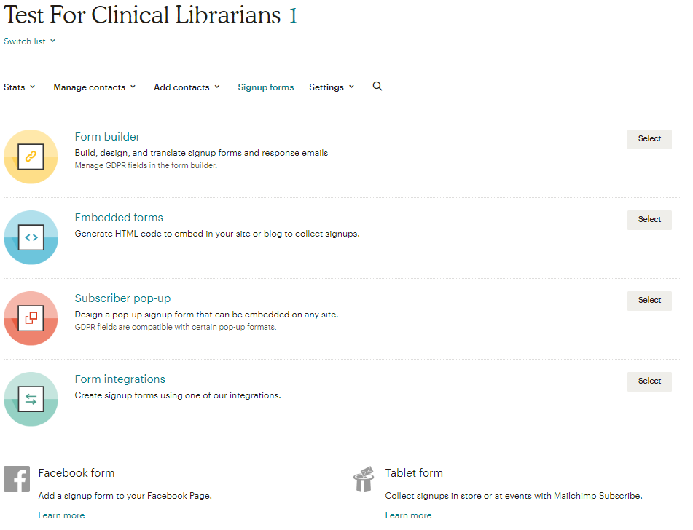
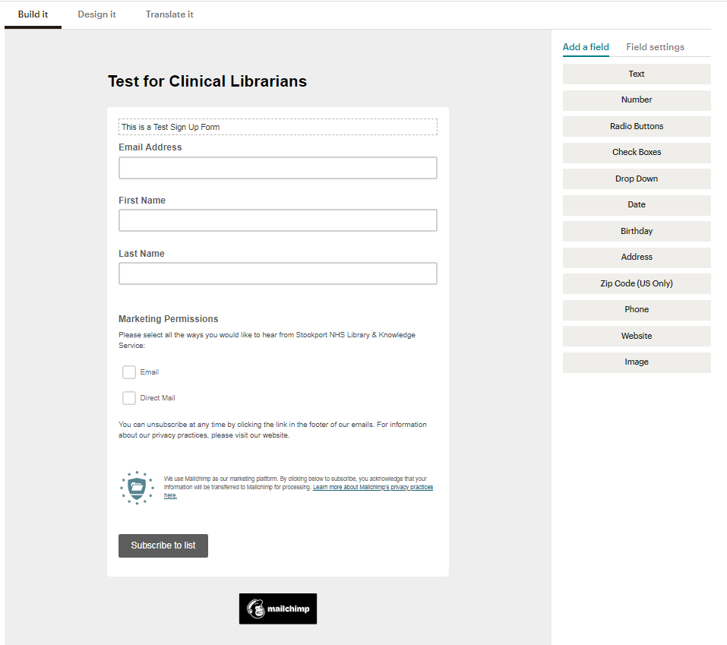
Sign Up Forms
Key Things
Puts the responsibility for sign up back onto the user – Good practice in terms of GDPR
Can link out to it from intranet/site/blog
Design process involves drag and drop
Remember key GDPR principles – if you don’t need to know it, don’t collect it.

Slide 6
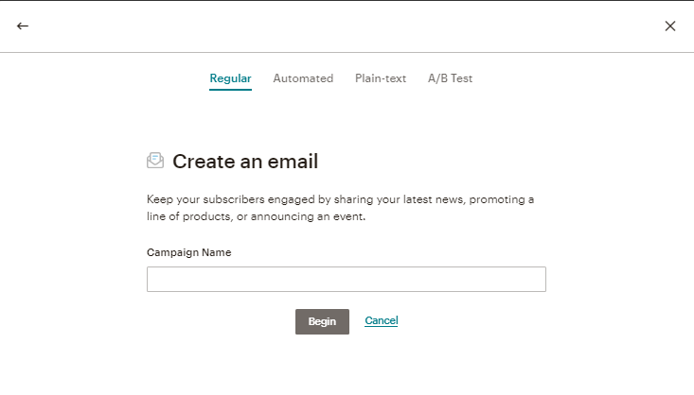
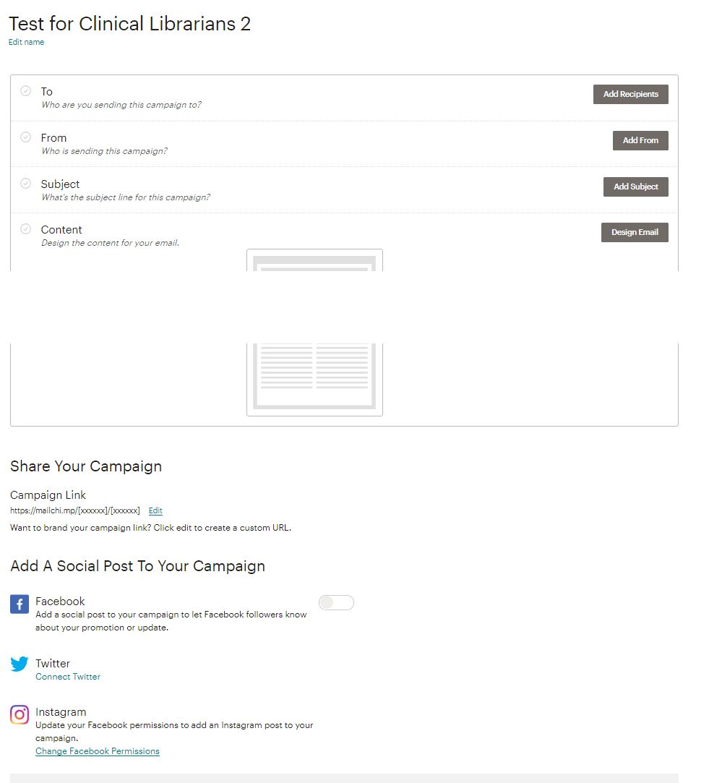
Content Route - Manual
Key Things
Are you manually creating a bulletin?
Fine control over look
Fine control over content
Takes Time
Do you have the ability to automate using feeds?
Control template design
Content relies on consistent feed creation
Set up time is reduced – do once and let it all happen!
Manual Bulletins

Slide 7
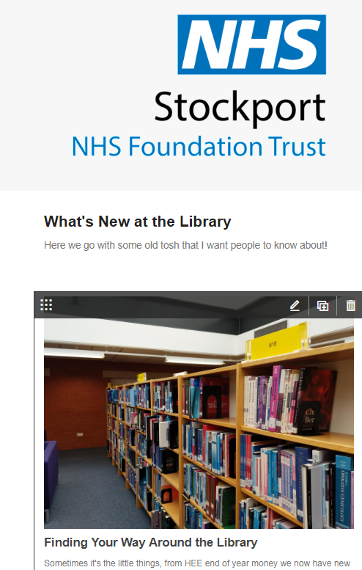
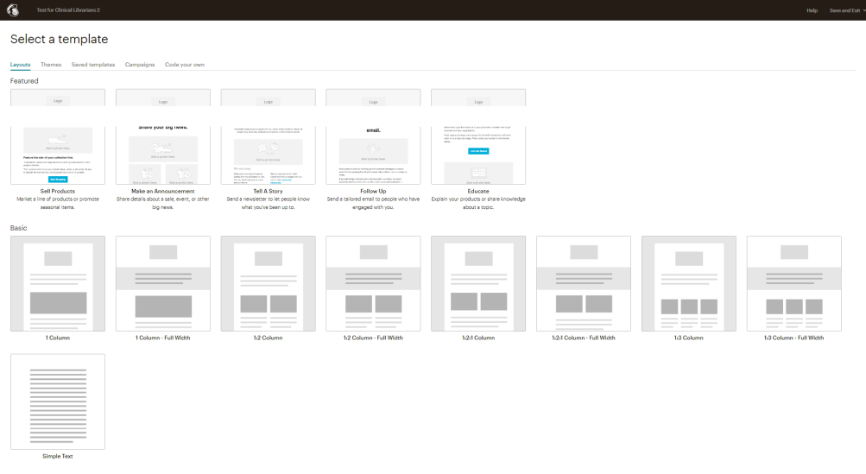
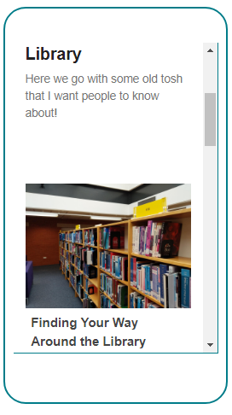
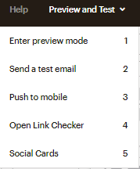
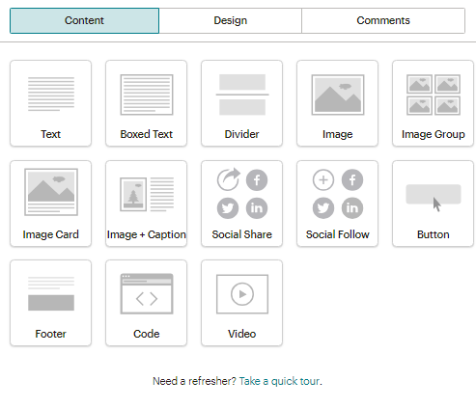

Content Route - Manual
You can upload your own images…..
Pick Your Template
Don’t forget…
Use Content Blocks to Design Bulletin
When you are happy hit send

Slide 8
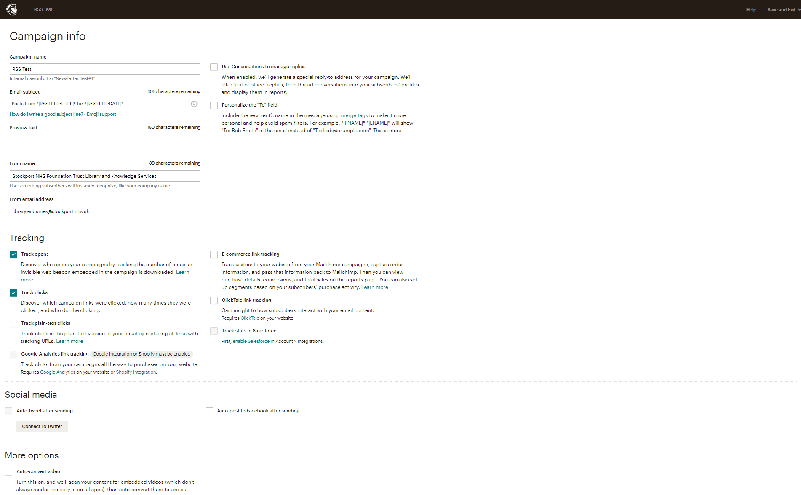
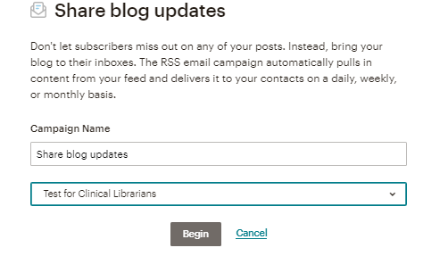
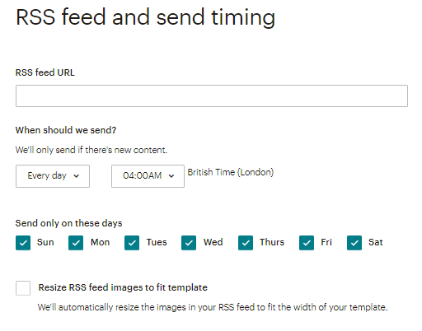
Content Route - Automated
Complete the campaign info
Think about tracking
Do you want to connect your bulletin to your social media
Key Things
For automated emails you need to know your feed address
Think about when you want to send it!

Slide 9
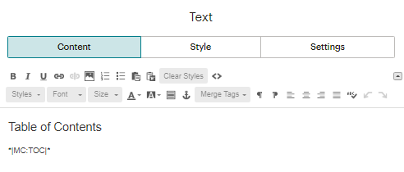
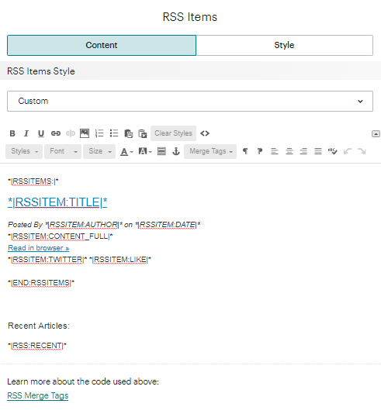
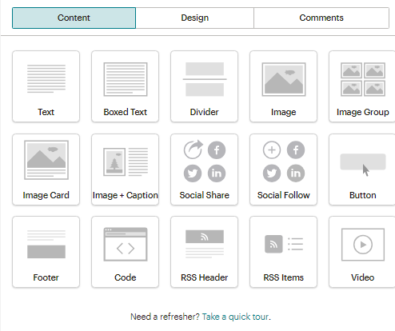
Content Route - Automated
To Add a Table of Contents
Add a text block with the following Mailchimp tag *|MC:TOC|*
Pick Your Template
To Contents
Add an RSS Item Block (I use custom blocks)
Table of Contents
*|MC:TOC|*
Use Content Blocks to Design Bulletin: Note RSS Content Blocks

Slide 10

Content Route - Automated
Don’t forget…
Table of Contents
*|MC:TOC|*
For these I tend to send a test email!
When I’m pleased with the Test email on the confirm page hit

Slide 11
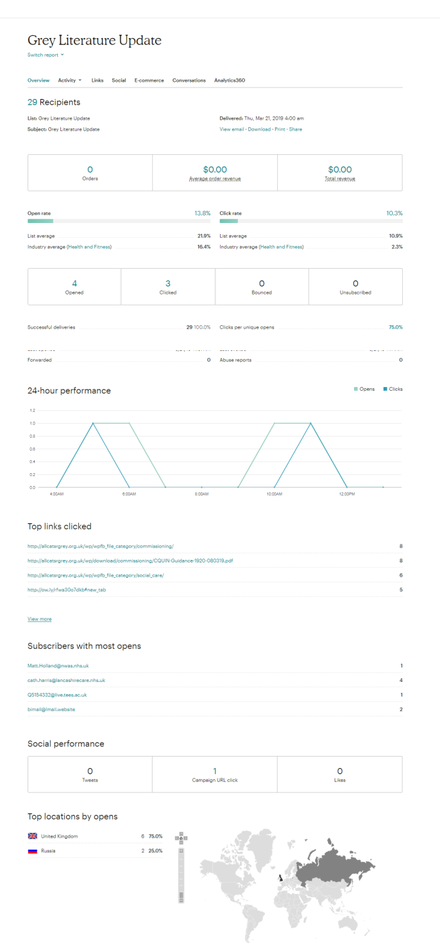
Monitoring Use
Monitoring Use
This is the interesting bit
Who opened your bulletin?
What did they click on?
Are you at industry average?
What does industry average mean?
Where are people from?
Was all the effort worth it?
Table of Contents
*|MC:TOC|*

Slide 12

Social Media Security

Slide 13
Social Media Security
Key Things
Why are you using it?
Who do you intend to be your audience?
What do you know about the tool?
Where are the settings?
What could possibly go wrong?
The art of the self edit! Or I’m going to lie about who I am!
Would I say it to my mother? (In my case, almost certainly)
Would I say it to my partner? (Yes, but I know it sometimes makes her cringe)
Is it about a train operator? (All is fair game with Northern Fail #commuterlife)
Have a stock phrase when you are hacked off that means nothing to anyone but you!
Hide your phone when you’ve had a few!
Golden Rules

Slide 14
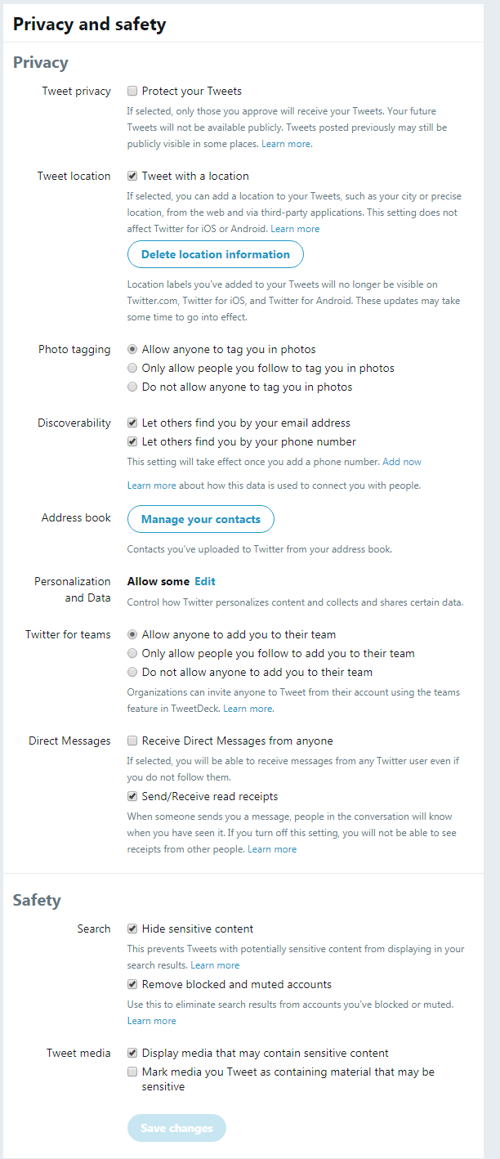
Twitter
Twitter is like a postcard – anyone can read your content
To alter that, go into your stream and click on your ident icon
Select privacy and safety – amend accordingly
Use twitter for the things you don’t mind people knowing…
Silence can be golden, but it doesn’t get library materials used!

Slide 15
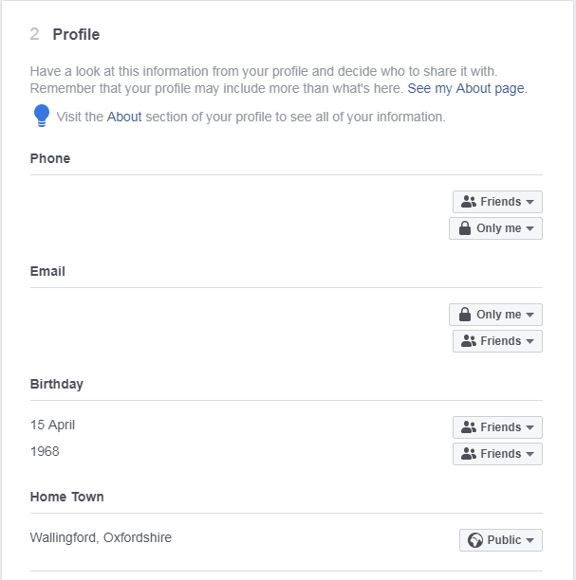

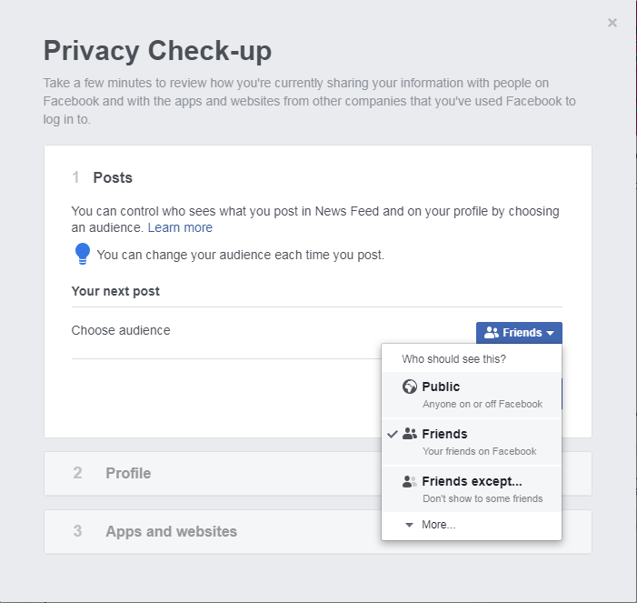
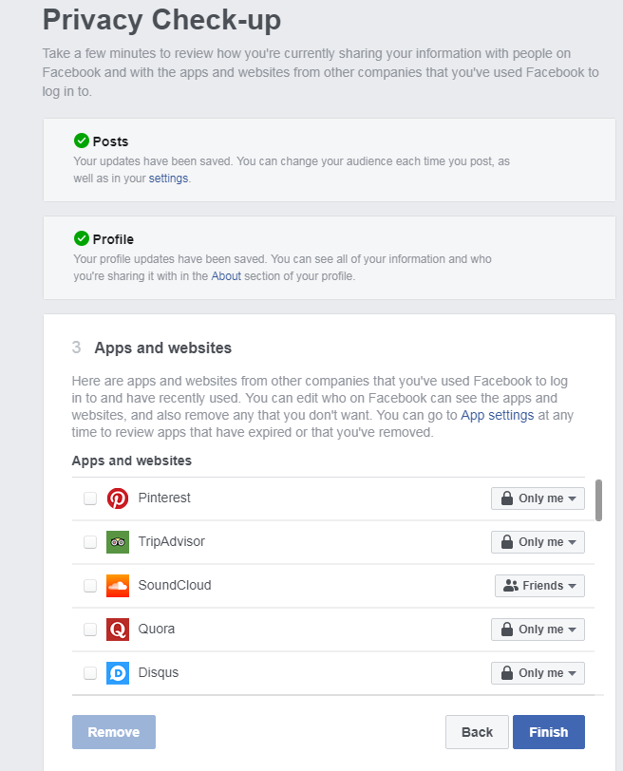
Facebook
Facebook Privacy Test ?

Slide 16
Facebook
Other things to think about
Details in profile – family members only can see my phone number
My current employer is not detailed
I think about the pictures I share.
I used to deal with FoI….

Slide 17

Questions & Comments

