Slide 1
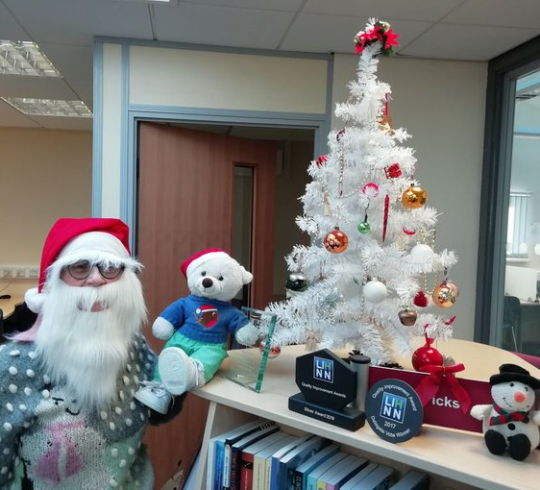
LIHNN CHRISTMAS QUIZ 2019

Slide 2
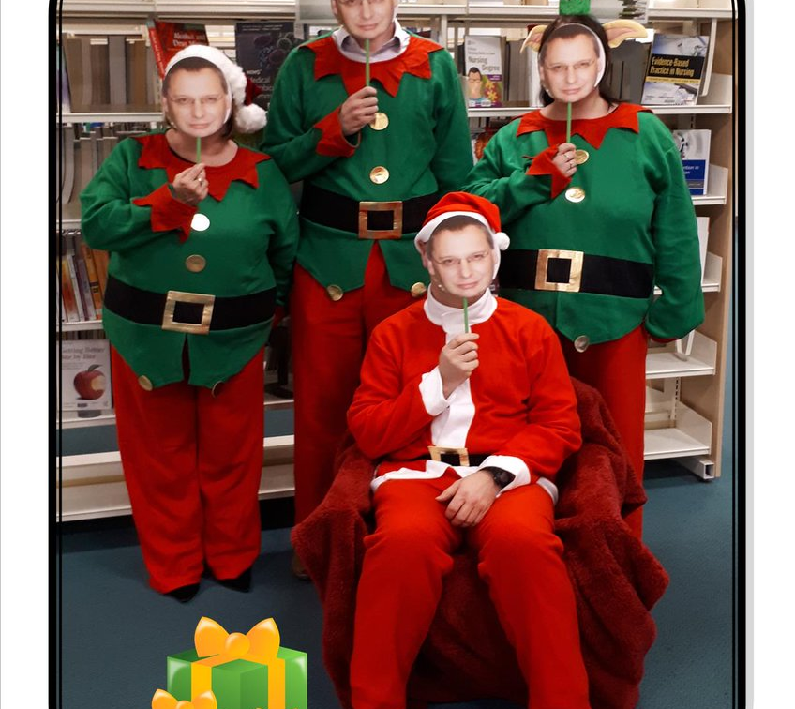
This is the punchline. What is the joke?
Claustrophobia!
A Holly Davidson!
Elf-is Presley!
Elf-ies!
Auld Fang Syne

Slide 3

Name that tune
Now, I know what a fool I've been
Sinatra was swinging, All the drunks they were singing
Do the fairies keep him sober for a day?
Santa Claus won't make me happy
When the snowman brings the snow

Slide 4
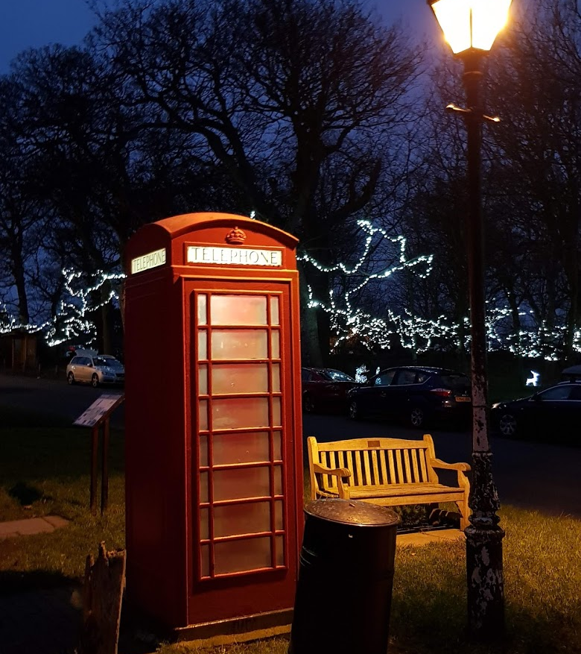
Name that movie
"try to stick to the four main food groups: candy, candy canes, candy corns and syrup"
“Hiya kids. Here is an important message from your Uncle Bill. Don't buy drugs. Become a pop star, and they give you them for free!”
“Yeah. I got invited to a Christmas party by mistake. Who knew?”
“Well, I'm more the 'I-don't-mind-pushing-my-best-friend-into-but-I'm-scared-stiff-when-I-get-anywhere-close-to-it-myselfing' kind.”
“There's more of gravy than of grave in you”

Slide 5

Christmas food
_UL_ / _O_
P _ _ _ _ T _ N _
_ R _ A D / S _ _ C _
R _ _ S_ /_ _ O _ E
_ I _ S/_ _ /_ L _ _ K _ T S

Slide 6
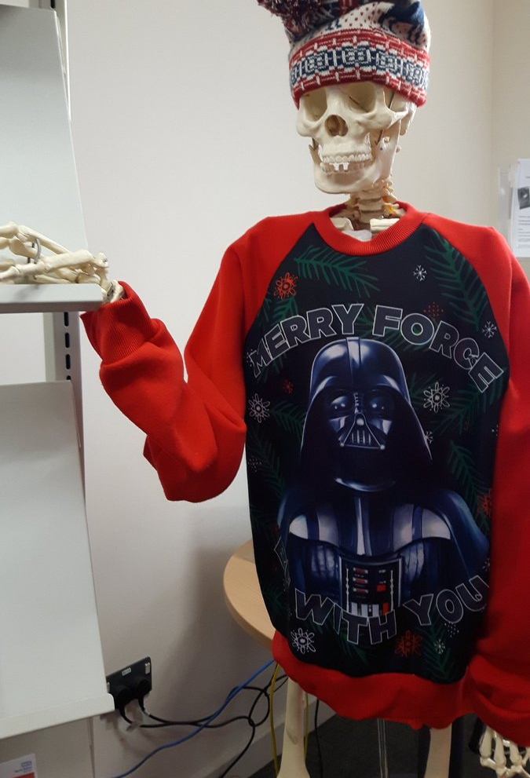
Christmas traditions
What are the names of the 8 reindeer, not including Rudolf, named in the song Rudolph, the Red-Nosed Reindeer by Gene Autry
What is John Calcott Horsley’s contribution to Christmas?
What type of tree is the Trafalgar Square Christmas tree?
Where are poinsettias native to?
When is stir up Sunday?

Slide 7
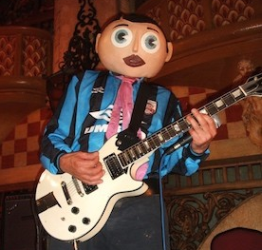
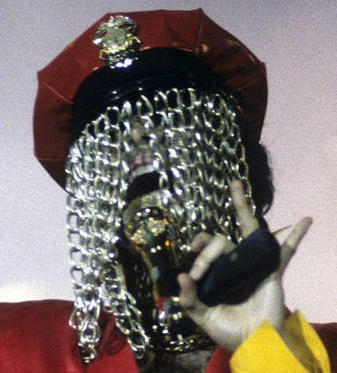
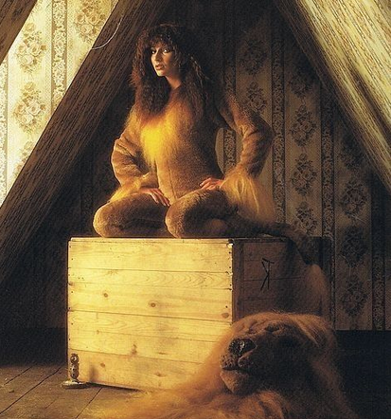
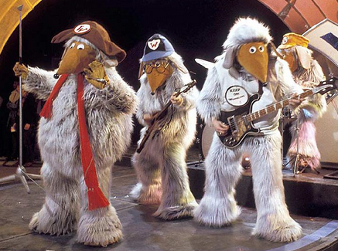
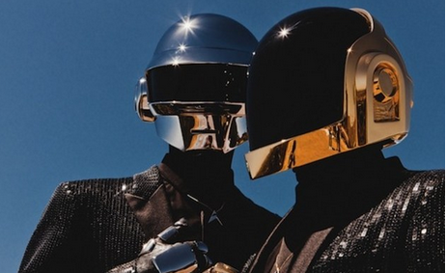
Behind the mask 1

Slide 8
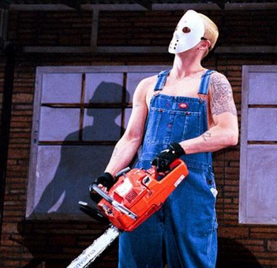
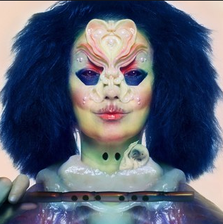
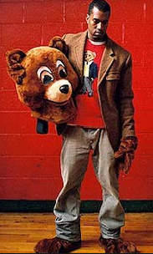
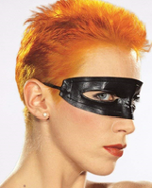
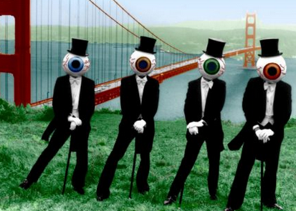
Behind the mask 2

Slide 9
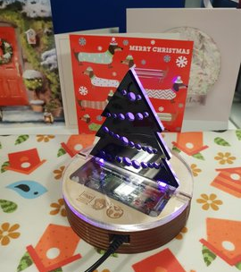
Answers - This is the punchline. What is the joke?
What does Santa suffer from if he gets stuck in a chimney?
What kind of motorbike does Santa ride?
Who is Santa's favourite singer?
What do elves post on Social Media?
What do vampires sing on New Year's Eve?

Slide 10
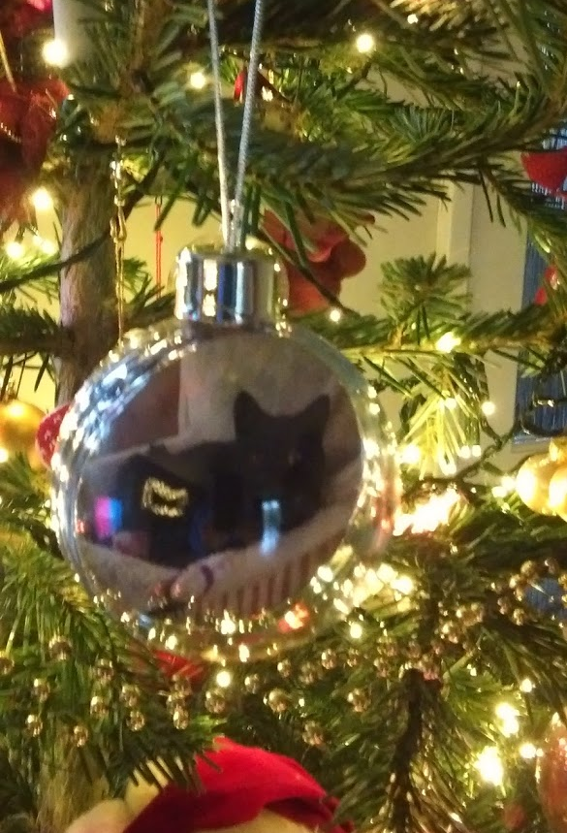
Answers – Name that tune and name that movie
Last Christmas
Fairy Tale of New York
Merry X-Mas Everybody
All I Want for Christmas Is You
I Wish It Could Be Christmas Every Day
Elf
Love Actually
Die Hard
White Christmas
A Christmas Carol

Slide 11
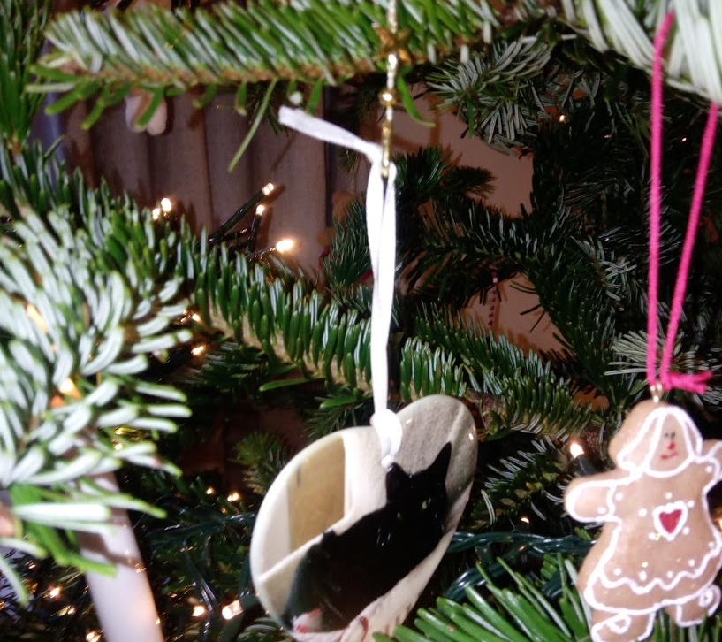
Answers – Christmas food and Christmas traditions
Yule Log
Panettone
Bread Sauce
Roast Goose
Pigs in Blankets
Dasher, Dancer, Prancer, Vixen, Comet, Cupid, Donner and Blitzen (8 points)
He printed the first Christmas card for Sir Henry Cole, the friend who had given him the idea
Norway spruce
Mexico
The Sunday before the beginning of the Advent season

Slide 12
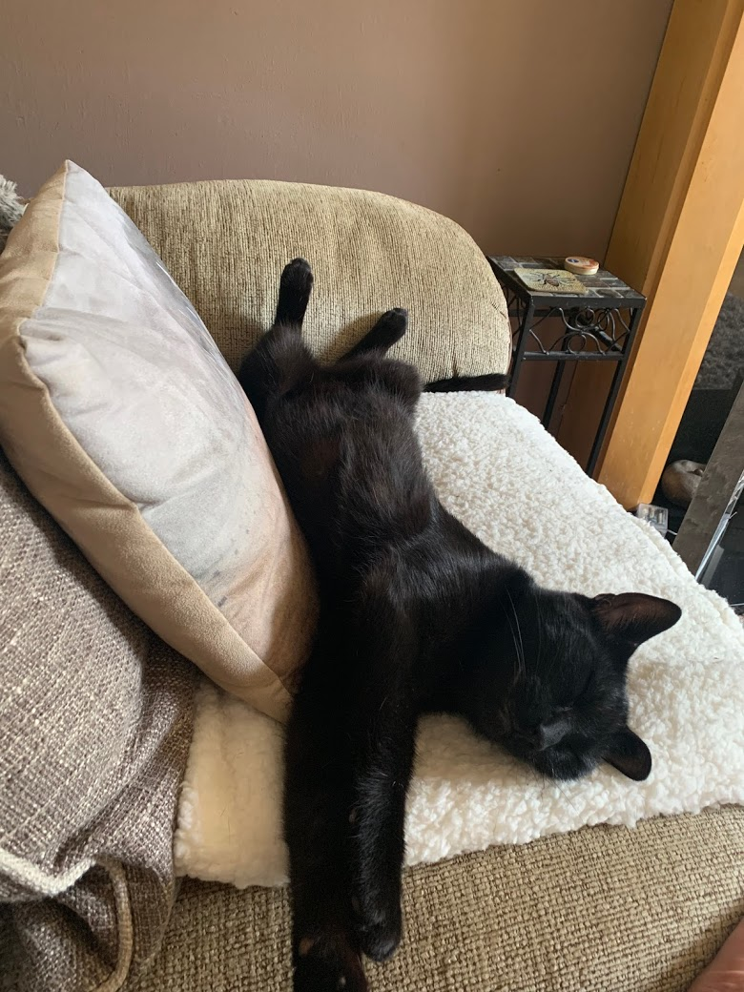
Answers – Behind the mask
Frank Sidebottom
Prince
Kate Bush
The Wombles
Daft Punk
Eminem
Bjork
Kanye West
Annie Lennox
The Residents

Slide 13


Happy Christmas Everyone
This Photo by Unknown Author is licensed under CC BY-NC

