Slide 1
Impact of targeted marketing of key resources during first wave of the COVID pandemic
Steve Glover, Head of Library Services
Manchester University NHS
Foundation Trust

Slide 2
Business Continuity Planning
Reviewed BCP in February 2020
Established a core team to maintain service & SLAs
OpenAthens Helpdesk
Support for Ambulance Services in England with NWAS LKS
Redeployment of some staff within Trust & Nightingale NW
Established COVID rotas with back up contingency
Focused marketing to promote the library & resources

Slide 3
Targeted marketing
Clinicians needed to retrain at short notice to staff COVID wards
Did not want to overwhelm staff with lots of resources
Selected a portfolio of resources including
1 Point of Care tool
8 key Oxford Handbooks & Specialist Handbooks
2 critical care journals
Plus literature searching

Slide 4

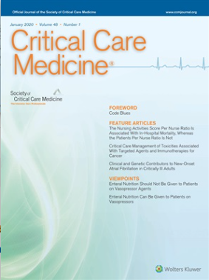
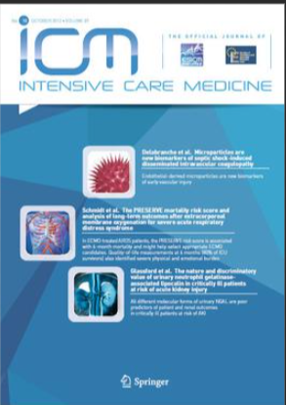

Slide 5
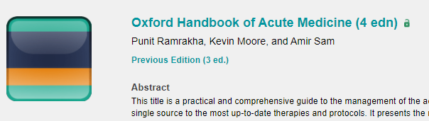

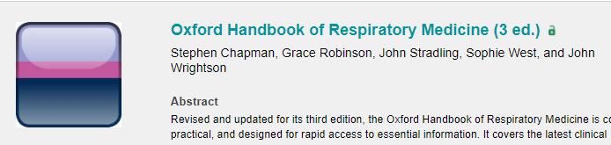

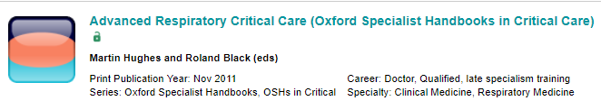

Slide 6
Marketing Campaign
Direct marketing via email
Working with Postgraduate and Undergraduate leads for access to training doctors and med students
Twitter

Slide 7
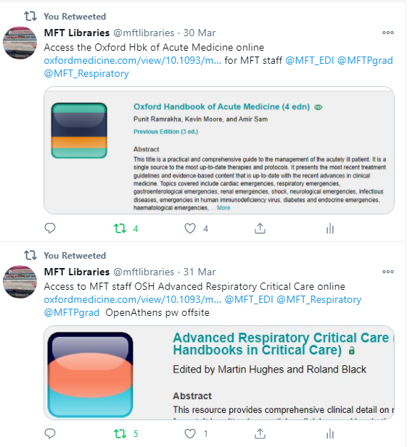

Slide 8
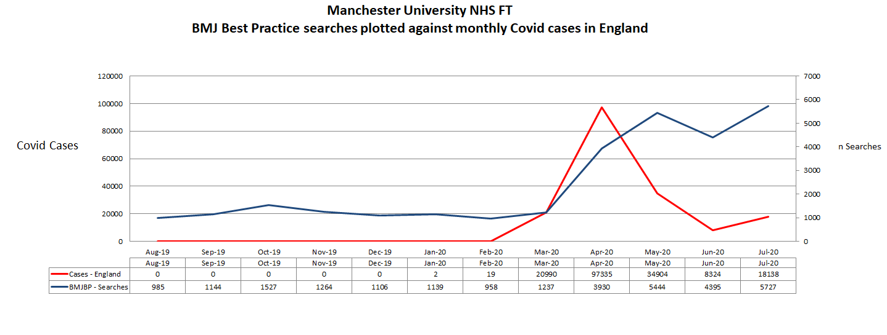

Slide 9
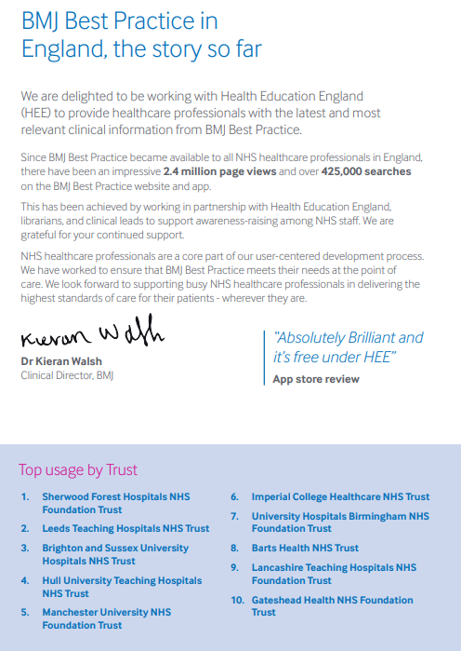
January 2020 – BMJ BP Newsletter

Slide 11
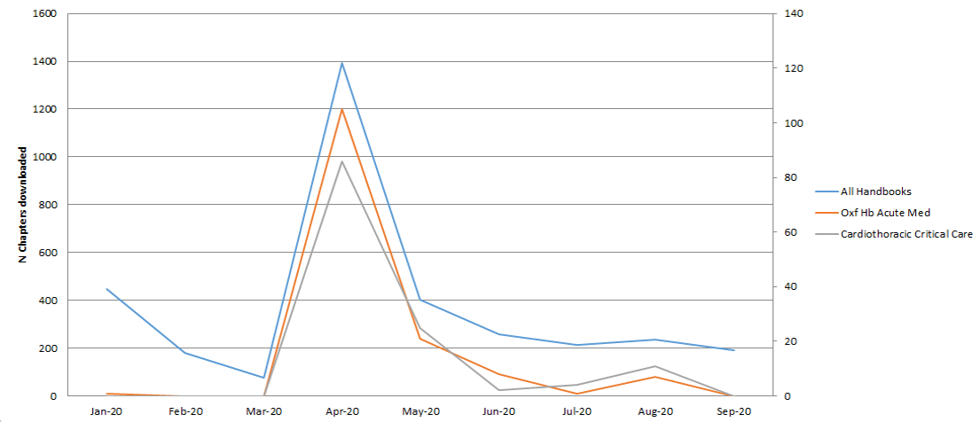
Oxford Handbooks BR2 usage data

Slide 12
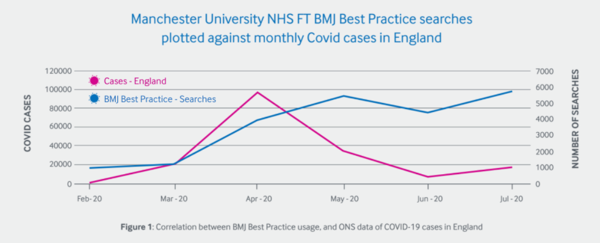
Takeaway messages and lessons learned
Direct marketing can be effective if used sparingly
Targeting specific resources to specialised groups
Keep up to date contact data in your LMS & systems
Work with your education partners – they can forward and cascade

