Slide 1
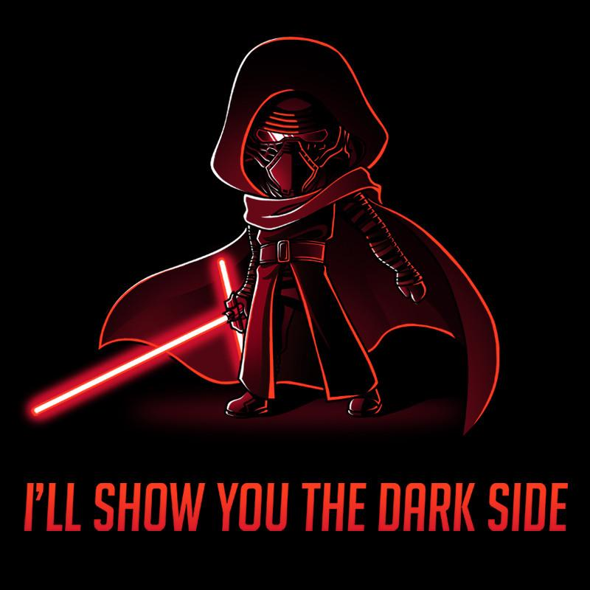
Notes:
Facebook world’s largest social networking site with more than 802 million active daily users.
People spend more than 700 billion minutes per month on Facebook alone sharing more than 30 billion pieces of content.
Twitter has 100 million active user accounts and 1 billion tweets sent every 7 days.
Snapchat launched in late 2011 it has more than 100 million active monthly users.

Slide 2
Social Media: A Cautionary Tale
RBH Staff Forum Question: Is it a requirement that we display our full name on our ID badge? Recently a relative tracked me on social media. This has happened to other people I know on my ward and throughout the hospital.
Notes:
How traceable are you? Hello my name is… campaign. Concerns raised by our clinical staff about social media use and traceable content. ‘Expert’ advice is generally focused on building a profile and increasing your following or friends base. Security aspects are mostly aimed at keeping children safe online. ***My Story***

Slide 3
@asmerryastheday
Miriam Salpeter -Social Networking for career success.
“Use a current, close-up picture of your face“

Slide 4

An active social media presence shows that
you or your organisation or service is dynamic and engaged
It’s all FAKE
Used strategically to promote and amplify issues and convey opinions
Self-disclosure concerns about privacy
Negative experiences due to others online activity
Reasons to Engage…. Or Not
Data Harvesting
It proves that you’re up to date with the latest trends & technologies
Used
Who has time?
Social media has changed the nature of communication
Media overload or boredom
Notes:
Evidence that users are visiting social media sites less.
‘‘social media fatigue’’. information overload -concerns about privacy - boredom among social media users.
Concerns over the level of self-presentation/self-disclosure and the consequences for personal security
Early adopter or young “aspirers” chase the newest trend - Remember Friends Reunited? Killed off by Face Book. The overcapacity of things to do online relative to user time. Having a presence on multiple platforms is burdensome.
14% of adults surveyed said they experienced negative consequences due to online activities by others including 21% who were fired from a job and 16% who lost out on getting a job.

Slide 5
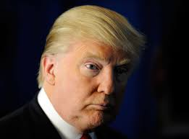
Influencers?
2017 New York Times – found one in eight Twitter posts by President Trump was a personal insult. He had insulted 394 people, places, and things on Twitter.
2017 Fox News poll- 70 percent of respondents said President Trump's tweets were hurting his agenda.
Notes:
Some perspectives on social media. A Social Media Influencer is a user on social media who has established credibility, they will have access to a large audience and can persuade others by virtue of their authenticity and reach. Donald Trump - 55 million followers.Is it nice and does it really help?

Slide 6
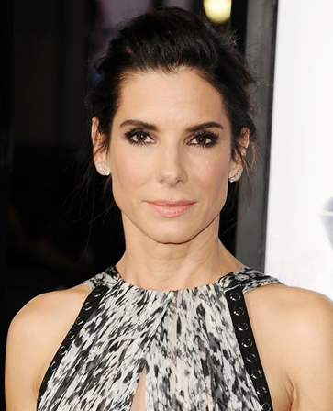
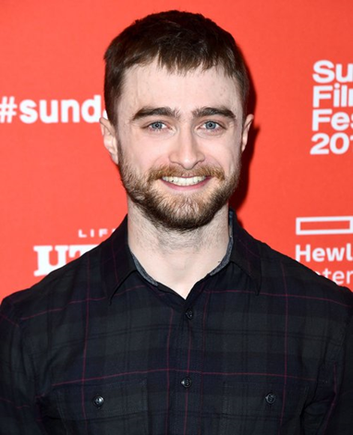
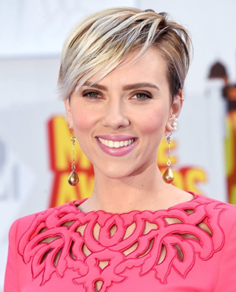
"I don’t have a Facebook or a Twitter account, I can’t think of anything I’d rather do less than have to continuously share details of my everyday life."
Daniel Radcliffe
Sandra Bullock
"We're not representing our lives truthfully, I will not take a selfie that I can't erase."
Scarlett Johansson
“If you go on Twitter and tell everybody what you're doing moment to moment and then claim you want a private life, no one is going to take that request seriously,"
Notes:
These views are on the same theme but show different perspectives as to why certain celebrities don’t have social media account, there are others- George Clooney, Kate Winslet, Daniel Craig, Benedict Cumberbatch have all spoken about why they don’t use social media. Ralph Fiennes believes modern language “is being eroded” into “a world of truncated sentences, soundbites and Twitter.”

Slide 7

Vicki Nash
Head of Policy and Campaigns - Mind
“It’s important to recognise that social media can have good and bad effects on us, and approach it appropriately.”
Notes:
There’s been a lot of focus on the impact of the trolling or bullying via social media on individual mental health, Vicki Nash agreed that this was a problem but points out that SM can also help people engage and is useful for signposting.

Slide 8
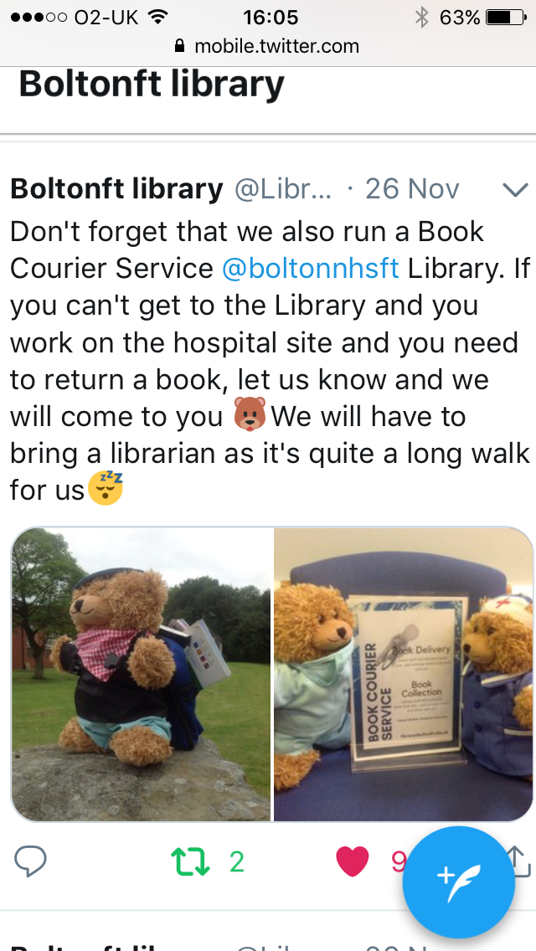
Meet The Book Bears
The fluffy side of social media
If you are going to use social media, be intentional and mindful of everything. The information you consume, share or create reflects who you are. Have a goal and adhere strongly to it.
Dr. Flo Falayi, Hybrid Leaders, Inc.
Notes:
This is what we do here in Bolton. Book Bear- Is the avatar you use on social media an important determining factor in the way other users see you?

Slide 9
Your Thoughts?

Slide 10
And finally- Some tips
on staying safe online.
1. lock down your privacy settings & handle passwords with care.
2. be discreet about your whereabouts, avoid location tags.
3. report duplicate friend requests and ignore requests from strangers.
4. don't use social credentials to sign into third-party sites.
5. avoid quizzes and games that require access to profile information.
6. remember to log off when you’re done.

