Slide 1
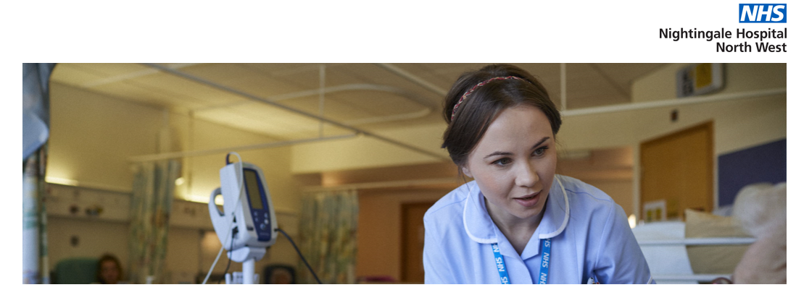
My experiences of working at the NHS Nightingale NW Hospital during COVID 19
Steve Glover, Head of Library Services
Manchester University NHS Foundation Trust

Slide 2
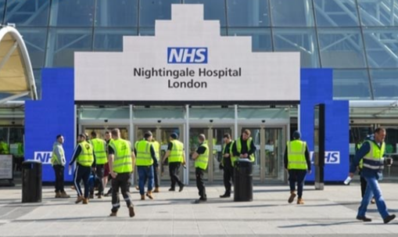
NHS Nightingale Hospitals
As cases rose quickly throughout March it became evident that current capacity to care for COVID patients may not be sufficient
We had seen China build two new COVID hospitals in weeks
We had seen hospitals in Lombardy and Spain struggle to cope
The UK government decided to create the Nightingale Hospitals to cope with excess demand for COVID patients
The first NHS Nightingale opened in London’s Excel Arena
The NW Nightingale opened shortly after at Manchester Central Conference Hall

Slide 3
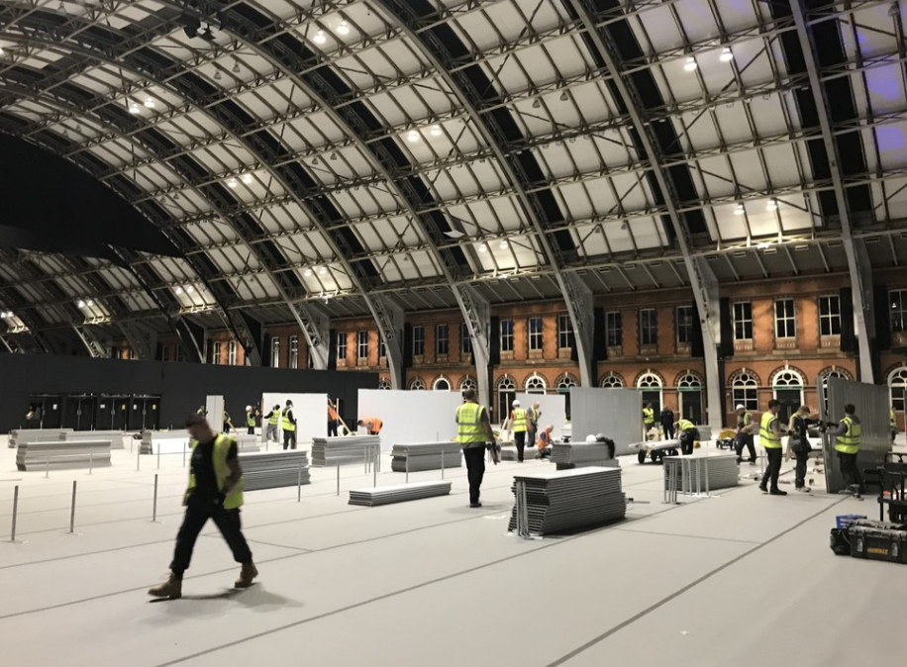

Slide 4

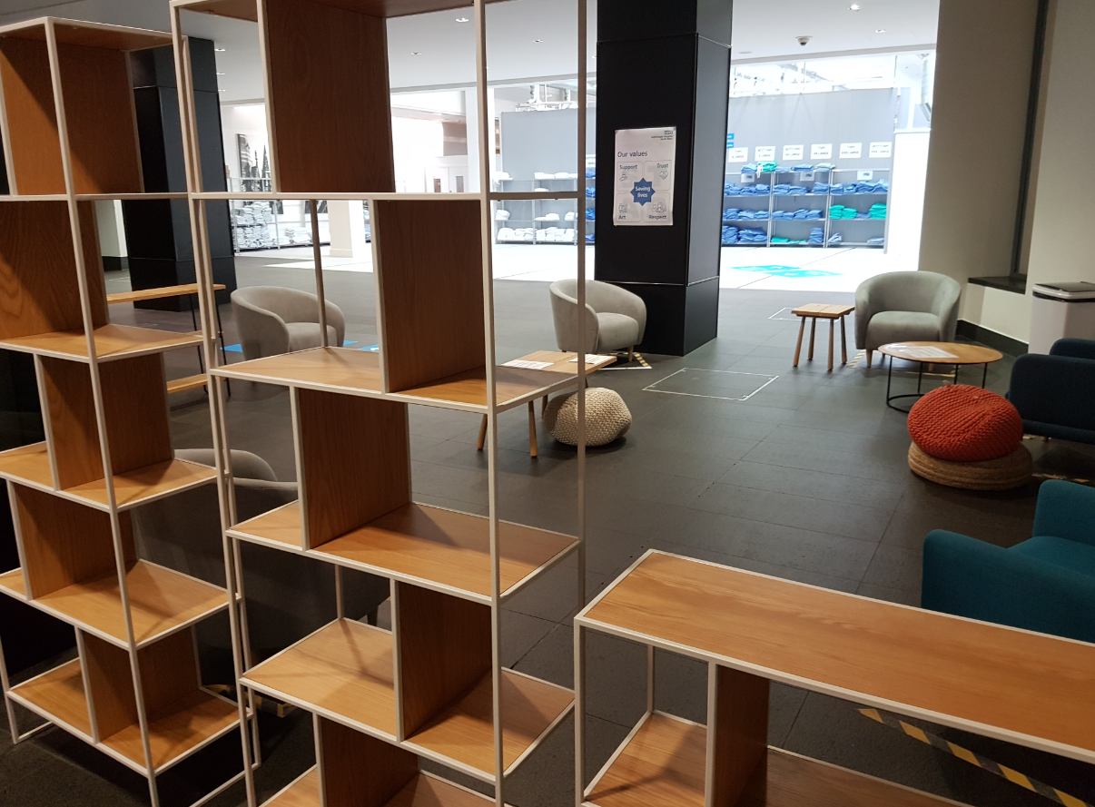
NHS Nightingale North West
The NW Nightingale operated on a different model to the London hospital
Step down patients …. 5 days post ICU & swabbing COVID +ve
Field Hospital: no complex underlying conditions
Referrals from 25 north west hospitals from Cheshire to Cumbria
18 Wards – 36 beds per ward in a Nightingale lay out
650 Bed capacity if needed
Patients would be moved quickly to local Critical Care if they deteriorated

Slide 5
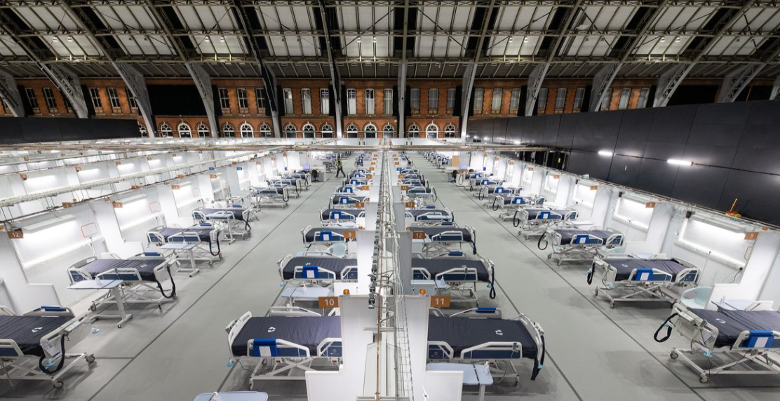

Slide 6
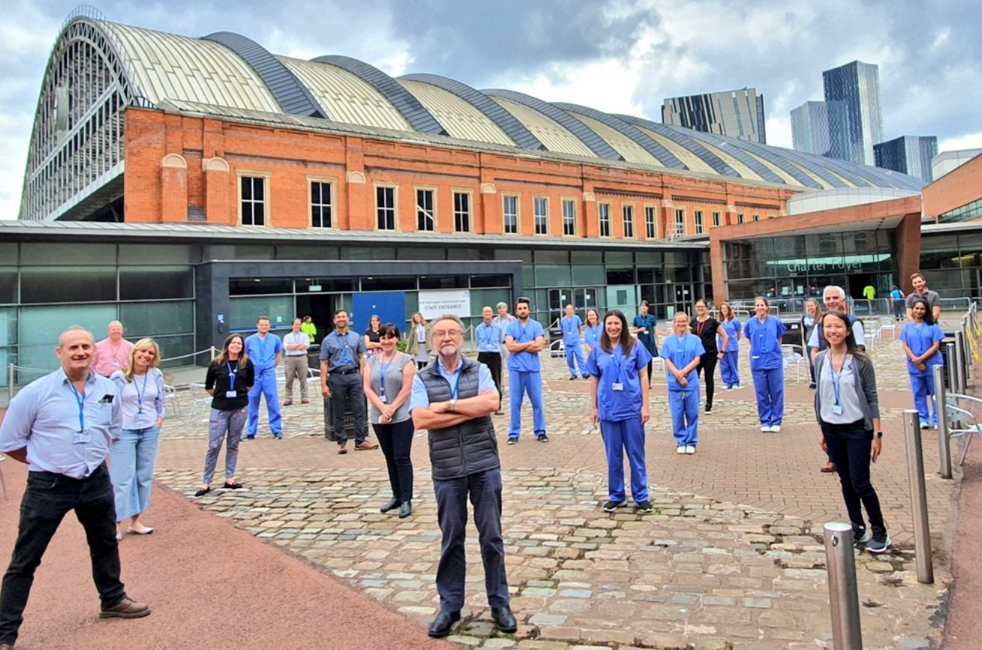

Slide 7
My role
I volunteered in early April when a call came out for staff
Induction at The Etihad Stadium over Easter weekend
I was one of four MFT library staff to work at the Nightingale
Following induction we had “aspirational interviews” on Easter Sunday to determine which roles we could carry out to make a contribution
I was given the role of Duty Operations Manager

Slide 8
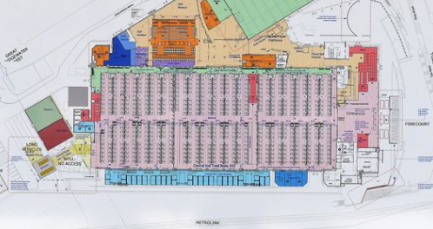

Slide 9
Duty Operations Manager
Based in the Operations Room
Bed Manager, NWAS Operations Admissions & Discharges, Medical Liaison, Nursing Liaison, Duty Manager
Bed capacity displayed in a live state on a big screen
Manage referrals through triage to an “accept” or “reject” status, working with medics, nursing, pharmacy, AHP, MH, & safeguarding teams

Slide 10
Duty Operations Manager
Work with NWAS to arrange transport to The NW Nightingale
Manage the Bed Manager and Ops admin team
Run the 9am and 4pm capacity meetings
Run a lunch time Ops call with referring hospitals and local hubs
Send a SitRep report to NHS England at 1900 each day

Slide 11
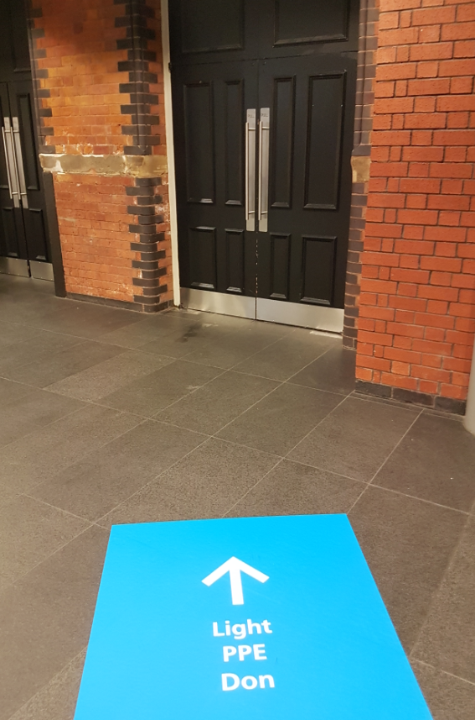
Operations admin team (“Ops”)
From Door to discharge
Admissions – PAS - paperwork
Patient flow (attend daily board round)
Discharge to residence
Liaise with local hubs for packages of care
Arrange discharge with NWAS
Daily multi-professional team meetings around flow and discharge

Slide 12
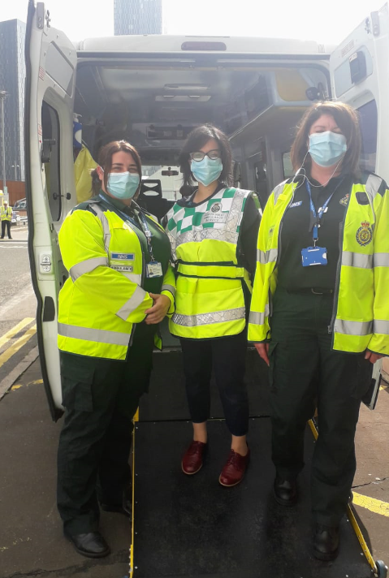
MFT Library staff at The Nightingale
Laura Russell – arrived on day one and worked with the set-up team prior to opening. Also worked on developing the systems flow for processes
Becky Walsh – Patient flow team from admissions to discharge (weekends)
Asma Ahmed – Patient flow team from admissions to discharge
  Working with clinicians
  Working on PAS & clinical systems
  Learning about discharge

Slide 13
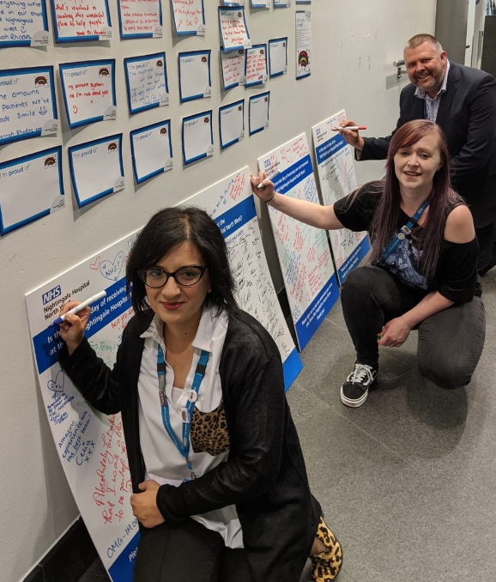
MFT librarians Signing out on our last day

Slide 14
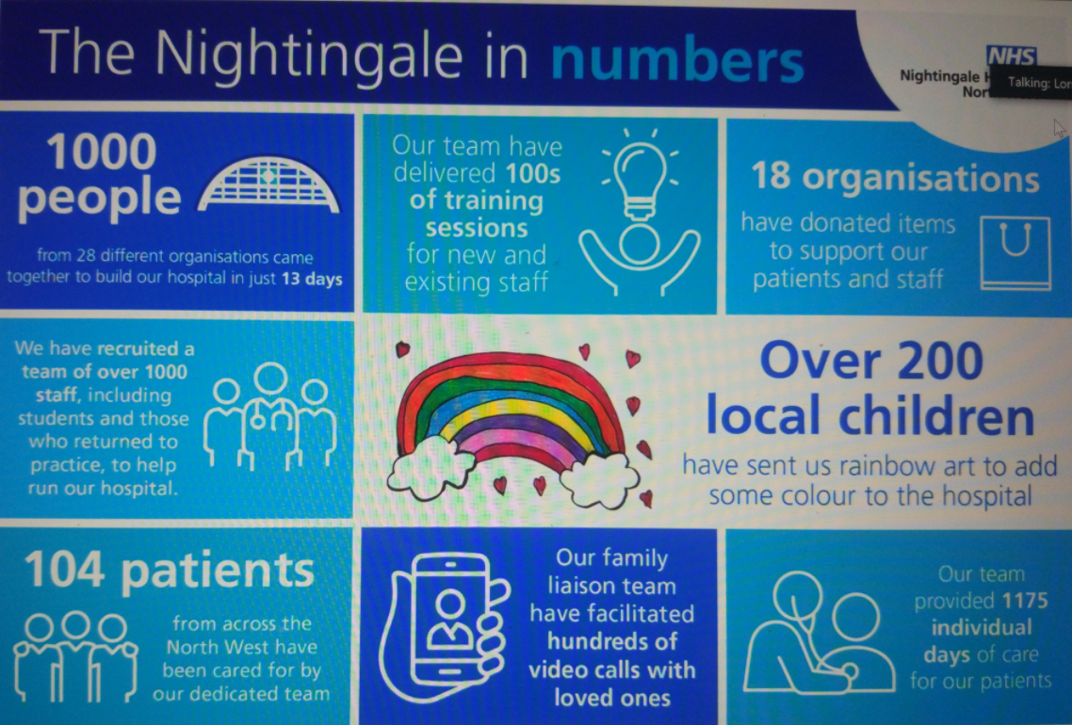

Slide 15
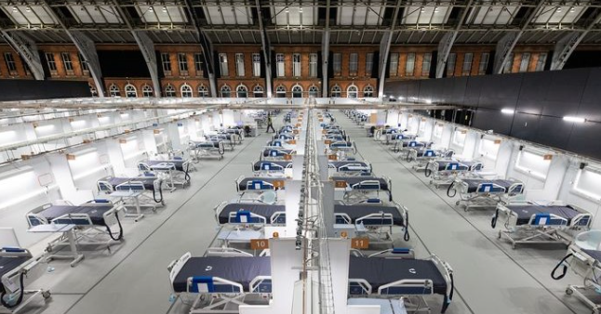
Experiences gained ……..
Working in an Ops room environment
Working with multi-professional clinicians
Multi agency systems
Working with NWAS controllers
Bed management and capacity decisions
Expect the unexpected

